Slide 1
GMT NEXT GEN TRANSIT PLAN
PROJECT OVERVIEW
February 21, 2017

Slide 2


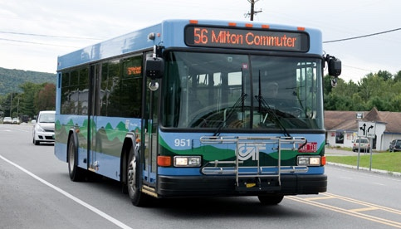
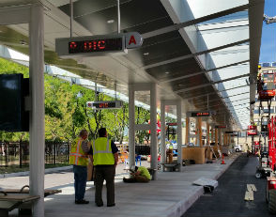
BACKGROUND
GMT has grown rapidly through “mergers and acquisitions”
Over recent years, more emphasis on organization and capital improvements than service
  Service consolidation
  Governance and management structures
  Unified branding
  Capital improvements (downtown transit center)
Most services still operate in similar manner as before mergers
This effort is designed to improve the way services work as a system

Slide 3
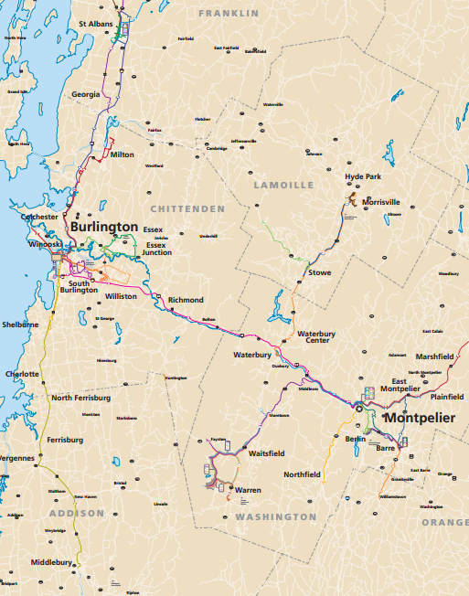
Starting point
Expansive service area across northern and central Vermont
Diverse service area with many types of transit
  Fixed-route service in urban areas
  Fixed- and deviated fixed-route service to rural communities
  Regional and commuter service
  Seasonal skier-oriented service
  Other specialized services
  More service types than many much larger systems

Slide 4
Ending point
Individual services that provide more attractive service
Individual services that are well integrated to form a strong system
Better service for existing riders
  Better service that will attract new riders

Slide 5
THE PROCESS
Stakeholder
Engagement
Analyze Existing Urban and Rural Services
Assess Customer Markets
Evaluation Framework
Develop Alternatives and Scenarios
Develop Recommended Plan
Implementation

Slide 6

1. Public Engagement
Communicate early and often
Be clear and transparent
Leverage existing groups
Clarity and transparency
Engage diverse and disadvantaged communities
Use technology

Slide 7
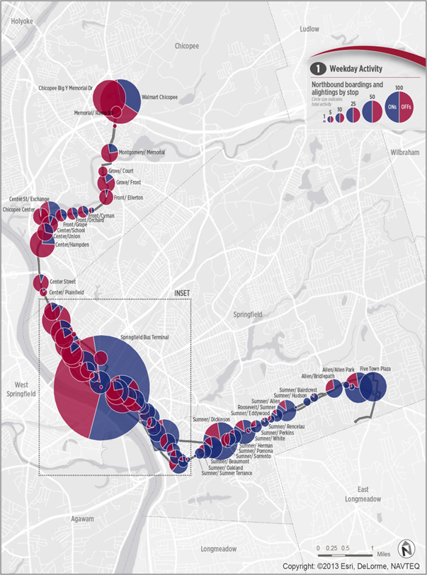
2. Analyze Existing Service
Overview of overall system
Bottom-up, detailed evaluation of each route
  Ridership by route, by time of day, and direction
  Ons and offs by stop and by time of day
  Maximum loads and load profiles
Identify strengths and weaknesses of each route
Identify potential improvements
PVTA Comprehensive Operations Analysis (Springfield, MA)

Slide 8
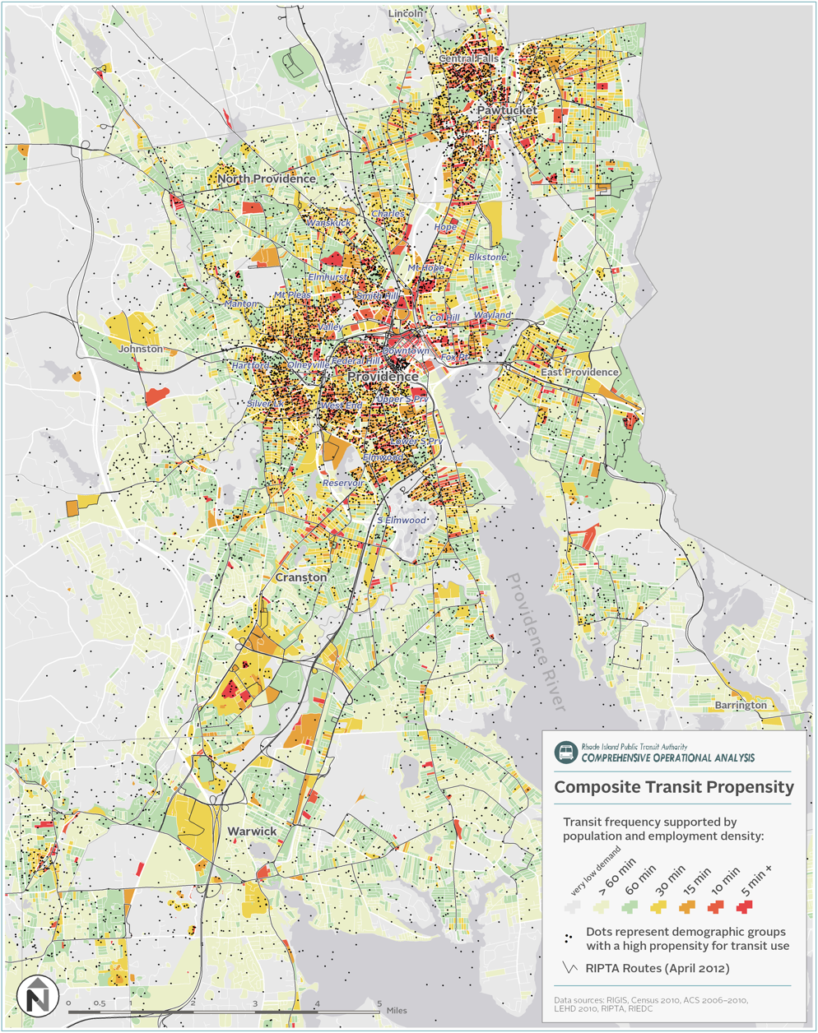
3. Conduct Market Analysis
Determine underlying demand for transit
Population and employment density
Socio-economic factors
Travel patterns
Location of major activity centers
RIPTA Comprehensive Operational Analysis (Providence, RI_

Slide 9
4. Develop vision, goals, and objectives
What kind of service do you want to provide?
How should trade-offs be made?
Decisions on how to make trade-offs are an important component of Board input
Coverage
Productivity
OR
Frequency
Span of Service
OR
Equity
Cost-Effectiveness
OR
Distance to Stops
Speed/Travel Time
OR
Walk Distance
Direct Routes
OR
Improve Existing
Expand to New Areas
OR

Slide 10
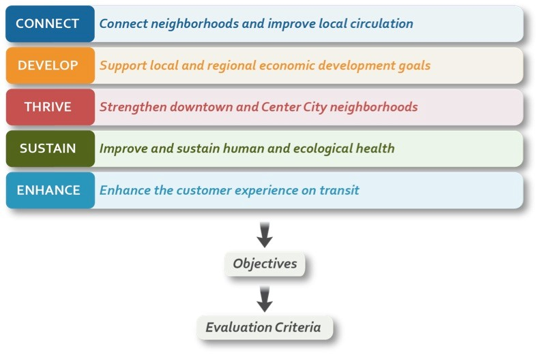
4. Develop vision, goals, and objectives
Themes, Goals, Objectives, and Evaluation Criteria
For example:
Cost per Passenger
Passengers per Revenue Vehicle Hour
Etc.

Slide 11
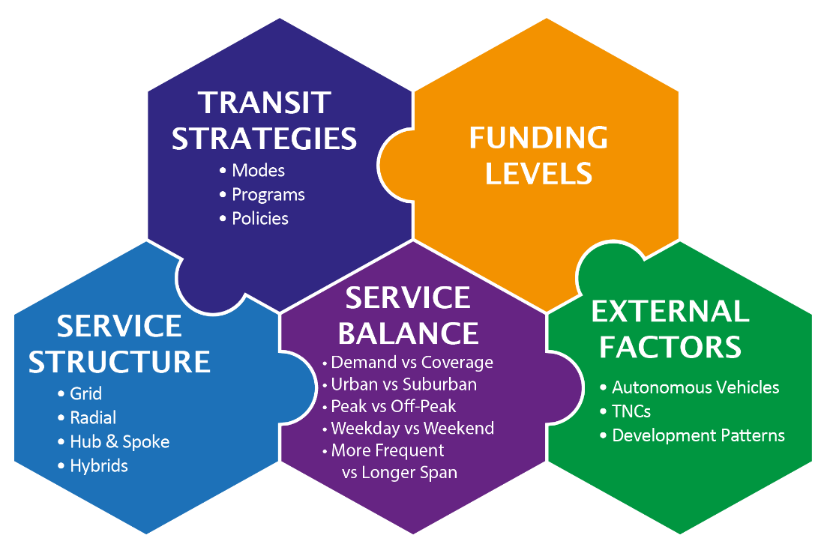
5. Develop Scenarios
There are many ways to provide great transit
Like a puzzle, many different pieces must fit together:
  Transit strategies
  Service structures
  Service balances (ways to make trade-offs)
  Other factors
But unlike a puzzle, the pieces can fit together in different ways

Slide 12
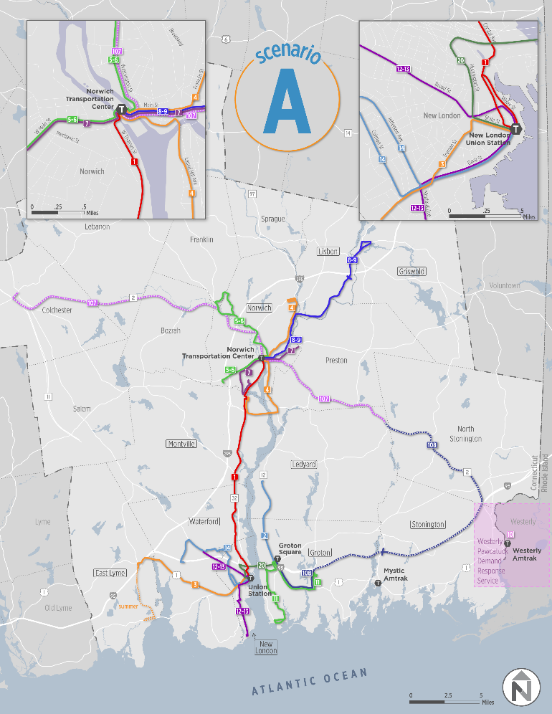
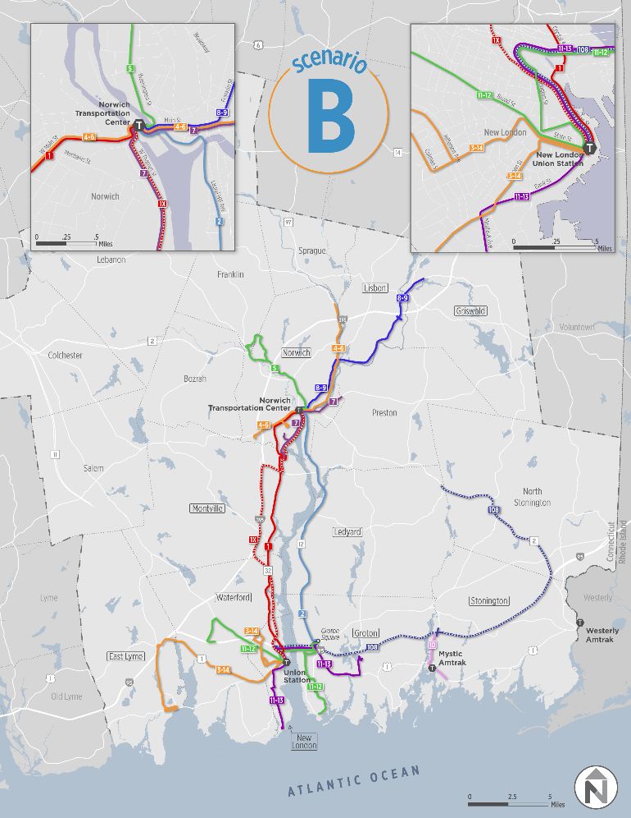
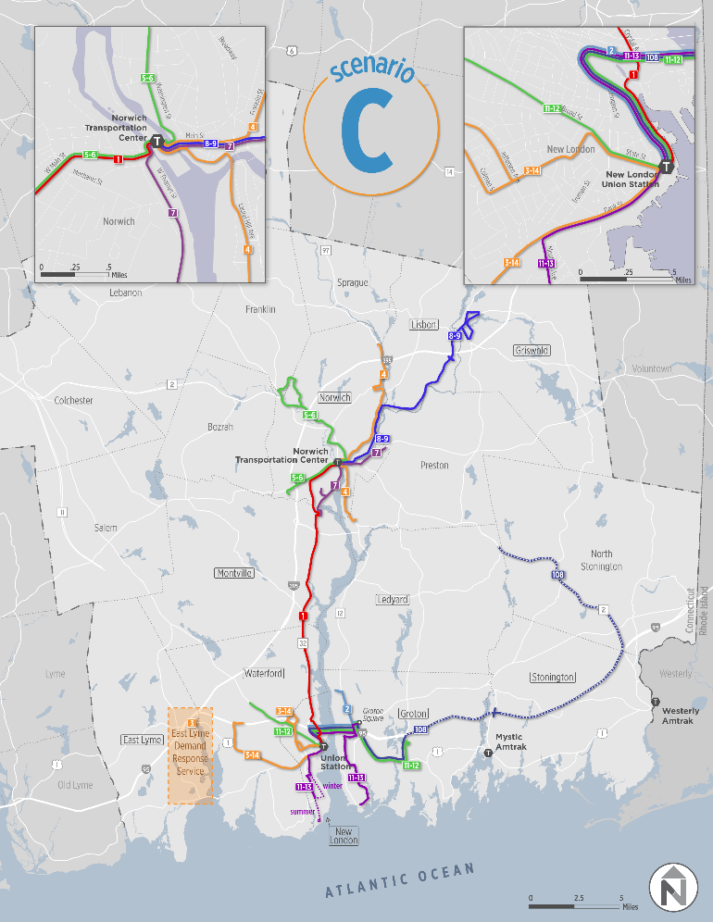
5. Develop Scenarios
Will develop and vet three different scenarios
Each will represent different ways to put the puzzle pieces together
Scenarios change discussion from “should changes be made?” to “what changes should be made?
SEAT Transit Study (New London/Groton, CT)

Slide 13
6. Develop Recommended Plan
Consistent with Vision
Stakeholder Preferences & Feedback
Recommendations
Technical Evaluation
Financial Constraints

Slide 14
timeline

