Slide 1
GMT NEXT GEN TRANSIT PLAN
CATMA ETC MEETING
MAY 11, 2017

Slide 2
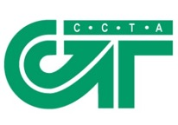

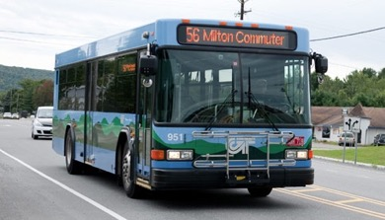
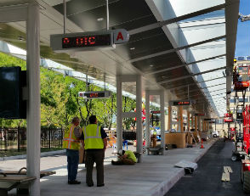
BACKGROUND
GMT has grown rapidly through “mergers and acquisitions”
Over recent years, more emphasis on organization and capital improvements than service
  Service consolidation
  Governance and management structures
  Unified branding
  Capital improvements (downtown transit center)
Most services still operate in similar manner as before mergers
This effort is designed to improve the way services work as a system

Slide 3
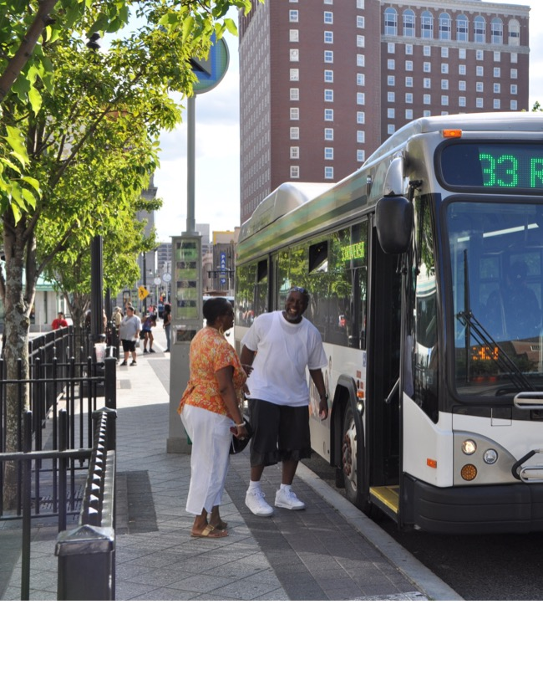
Goals
Individual services that provide more attractive service
Individual services that are well integrated to form a strong system
Better service for existing riders
  Better service that will attract new riders

Slide 4
PROJECT OVERVIEW AND SCHEDULE
Comprehensive evaluation of all GMT services

Slide 5
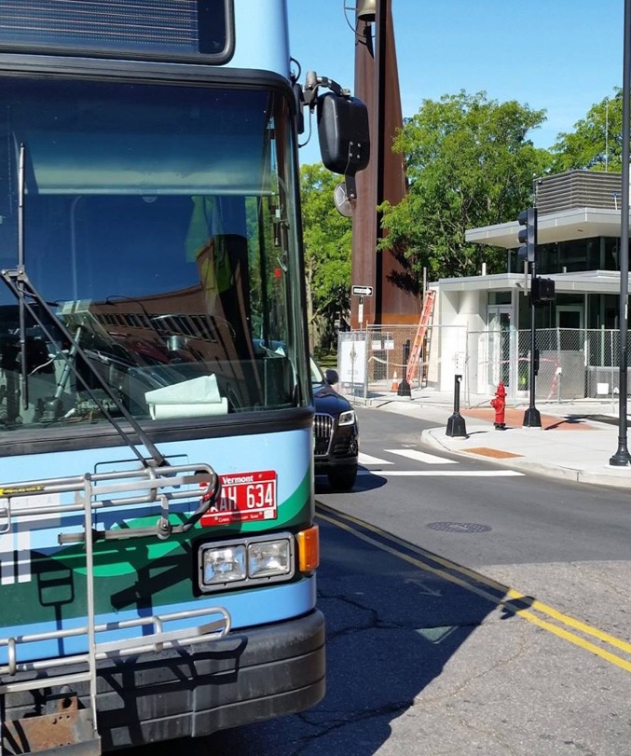
Interesting facts: Number of routes
Number
of Routes
GMT 53

Slide 6
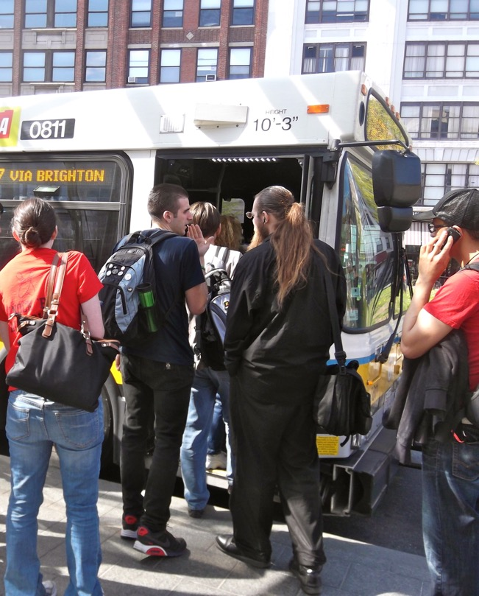
Interesting facts: Number of routes
Number
of Routes
GMT 53
Boston MBTA >200

Slide 7
Interesting facts: Number of routes
Number
of Routes
GMT 53
Boston MBTA >200
Nashville MTA and RTA 46

Slide 8
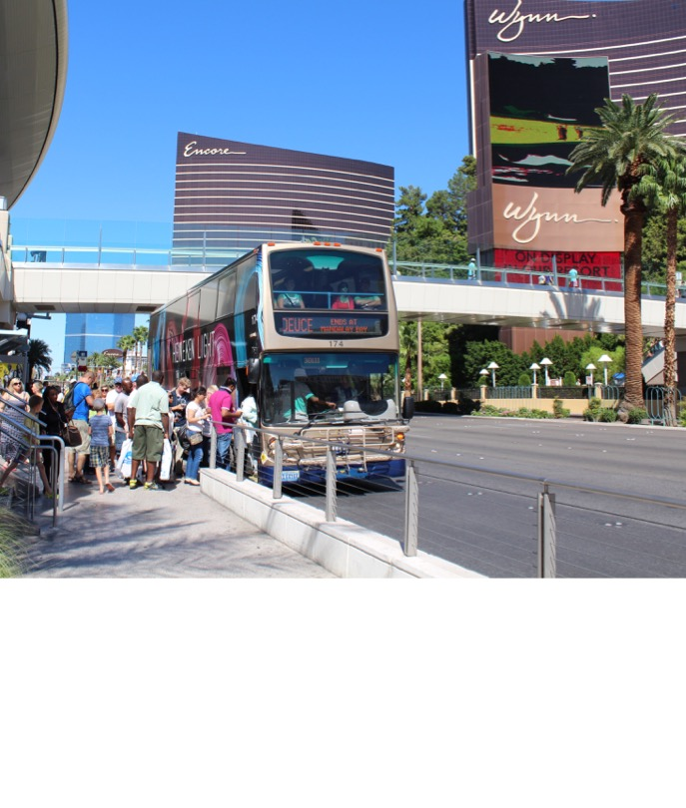
Interesting facts: Number of routes
Number
of Routes
GMT 53
Boston MBTA >200
Nashville MTA and RTA 46
Las Vegas RTC 39

Slide 9
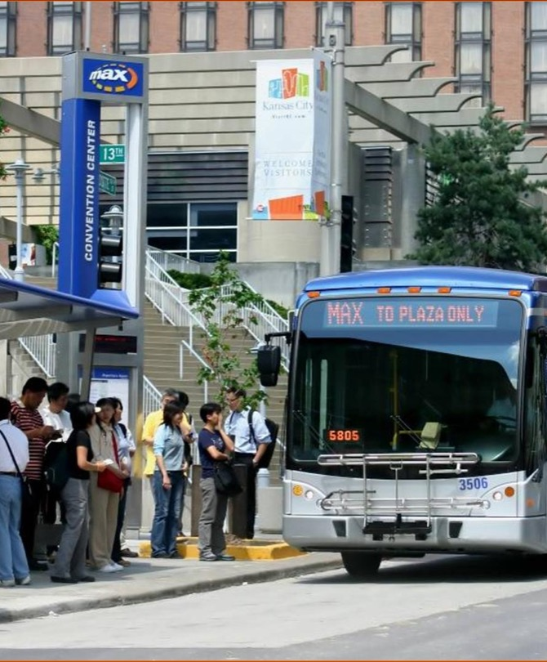
Interesting facts: Number of routes
Number
of Routes
GMT 53
Boston MBTA >200
Nashville MTA and RTA 46
Las Vegas RTC 39
Kansas City Ride KC 56

Slide 10
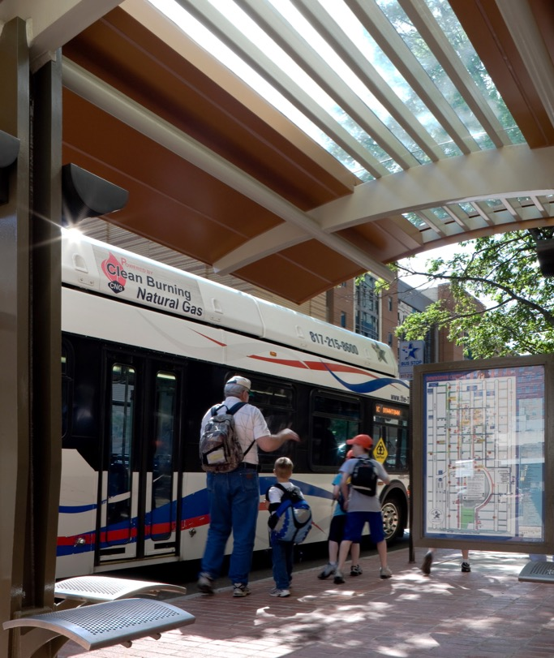
Interesting facts: Number of routes
Number
of Routes
GMT 53
Boston MBTA >200
Nashville MTA and RTA 46
Las Vegas RTC 39
Kansas City Ride KC 56
Fort Worth The T 41

Slide 11
Interesting Facts: Types of Service
Boston MBTA
  Rapid transit (subway)
  Light rail
  Bus Rapid Transit
  Local bus
  Commuter rail
  Express bus
  Ferry
Total types of service = 7

Slide 12
Interesting Facts: Types of Service
Nashville MTA & RTA
  “BRT-lite”
  Local bus
  Commuter rail
  Express bus
Total types of service = 4

Slide 13
Interesting Facts: Types of Service
Las Vegas RTC
  Rapid Bus
  Local bus
Total types of service = 2
Note: Las Vegas also has a privately run monorail

Slide 14
Interesting Facts: Types of Service
Kansas City Ride KC
  Streetcar
  Rapid Bus (MAX)
  Local bus
  Express bus
  Flex service
Total types of service = 5

Slide 15
Interesting Facts: Types of Service
Fort Worth The T
  Rapid Bus
  Local bus
  Express bus
  Flex service
Total types of service = 4

Slide 16
Interesting Facts: Types of Service
GMT
  Local bus (urban and rural)
  Express/commuter bus
  Demand-response
  Deviated fixed-route
  Seasonal services
  (Mad River Valley, Stowe,
  and Montpelier)
  Shopping shuttles
Total types of service = 6

Slide 17
Putting it into Perspective
GMT is not a small system
More routes than many major urban systems
More types of services than many major urban systems
53 routes 6 types of service

Slide 18
What People Usually Want
What’s Important to You?
Fewer transfers
More weekend service
Shorter walks to stops
More direct service
More frequent service
Faster service
Longer hours
Faster service

Slide 19
Trade-offs
No transit system can do everything; trade-offs must be made

Slide 20
Why Trade-offs matter
How trade-offs are made will:
  Reflect community values
  Determine what areas are served
  Determine the total number of people who are served
  Determine system productivity

Slide 21
BREAK-OUT SESSION
Break up into three groups
Quick vote on how you’d make trade-offs
Then discuss your choices
Vote again
Present final results and rationale

Slide 22
www.ridegmt.com/nextgen/

