Slide 1
GMT NEXTGEN TRANSIT PLAN
OVERVIEW OF CHANGES INCLUDED/
NOT INCLUDED IN SCENARIOS
DECEMBER 11, 2017

Slide 2
GENERATION OF IDEAS
Over 200 changes considered
Sources of Ideas
  CCTA TDP (51)
  GMTA TDP (21)
  NextGen (89)
  Stakeholders (many)

Slide 3
Differences between nextgen & Tdps
TDPs
  Not cost-constrained
  Limited consideration of demand
  No cost estimates
NextGen
  Short-term changes
  Match service levels with demand
  Scenarios consider costs – up to 20% increase in operating costs

Slide 4
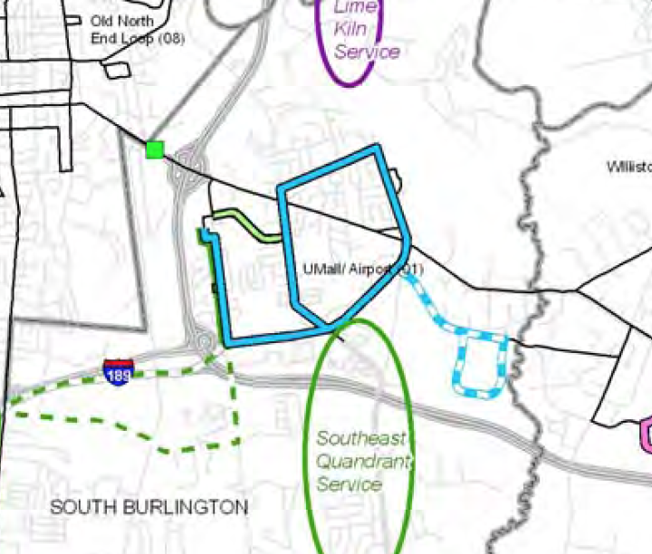
Example: Route 12 Umall/Airport
TDP Recommendation
  Weekdays
    5 AM to midnight (2 AM on Fridays)
    Every 15 to 30 mins
  Saturdays
    6 AM to 2 AM
    Every 20 to 30 mins
  Sundays
    6 AM to 10 PM
    Every 30 mins

Slide 5
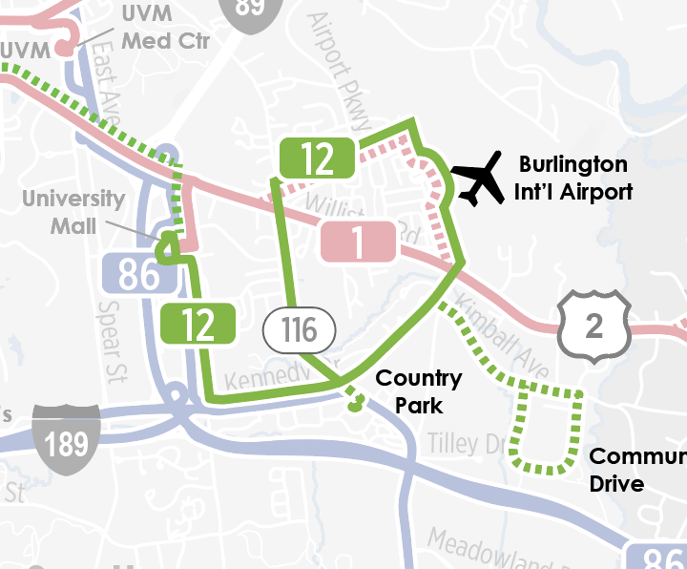
Example: Route 12 Umall/Airport
GMT Implementation
  Weekdays
    6:25 AM to 10 PM
    Every 30 to 70 mins
  Saturdays
    6:30 AM to 9:50 PM
    Every 30 to 60 mins
  Sundays
    8:45 AM to 7;35 PM
    Every 7 mins
  Ridership
    Weekdays: 256
    Saturdays: 154
    Sundays: 161

Slide 6
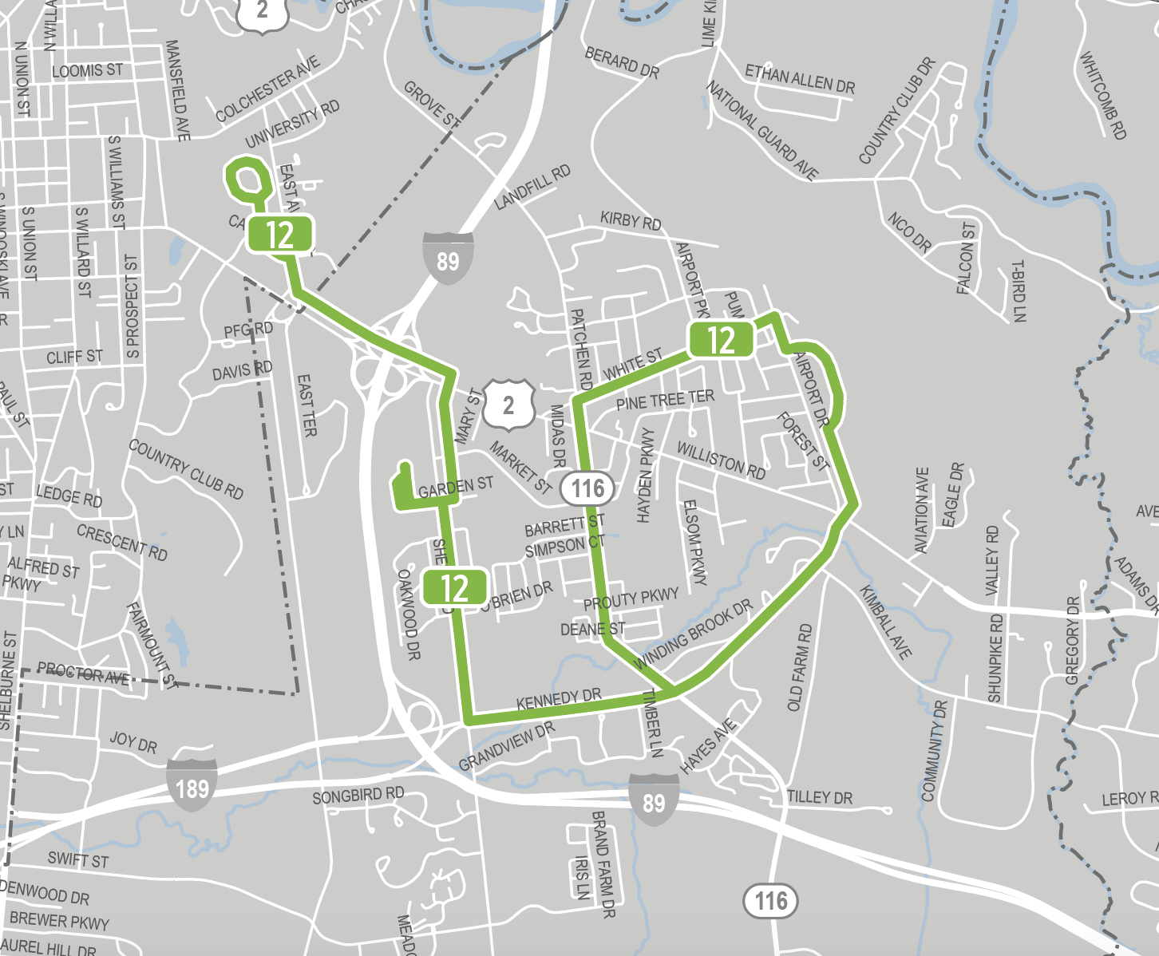
Example: Route 12 Umall/Airport
NextGen Scenario 1
  Weekdays
    5 AM to 6 PM
    Every 60 mins
  Saturdays
    5 AM to 6 PM
    Every 60 mins
  Sundays
    5 AM to 6 PM
    Every 60 mins
  Rationale
    Changes match service levels with relatively low demand

Slide 7
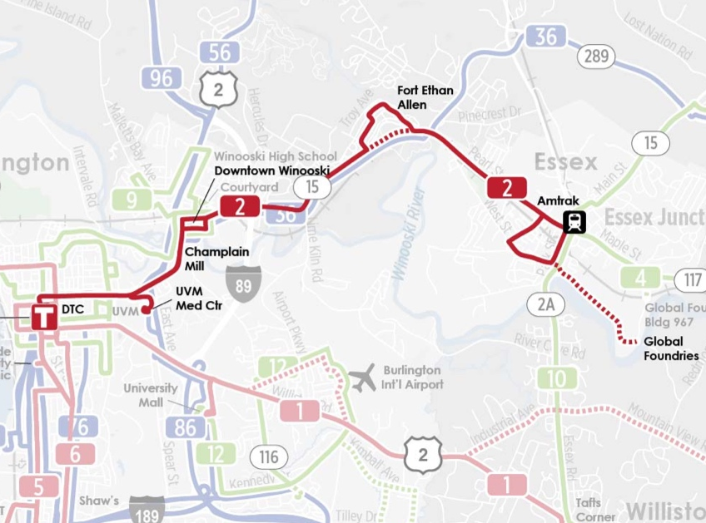
Example: Route 2 Essex
Existing Service
  Weekdays
    5:45 AM to 12:10 AM
    Every 30 to 70 mins
  Saturdays
    6:10 AM to 12:10 AM
    Every 30 to 75 mins
  Sundays
    8 AM to 9:15 PM
    Every 75 mins
  Ridership
    Weekdays: 1,551
    Saturdays: 736
    Sundays: 248

Slide 8
Example: Route 2 Essex
TDP Recommendation
  Weekdays
    5 AM to midnight (2 AM on Fridays)
    Every 15 to 30 mins
  Saturdays
    6 AM to 2 AM
    Every 20 to 30 mins
  Sundays
    6 AM to 10 PM
    Every 30 mins

Slide 9
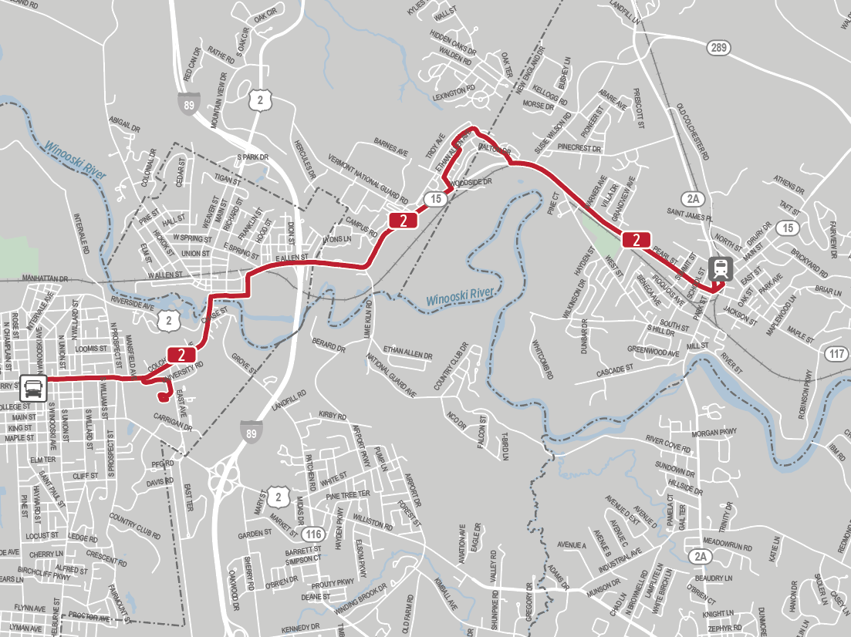
Example: Route 2 Essex
NextGen Scenario 1
  Weekdays
    5:30 AM to 11 PM
    Every 20 to 30 mins
  Saturdays
    6:15 AM to 10 PM
    Every 20 to 30 mins
  Sundays
    & AM to 8 PM
    Every 30 mins
  Rationale
    High demand; move toward TDP recommendation

Slide 10
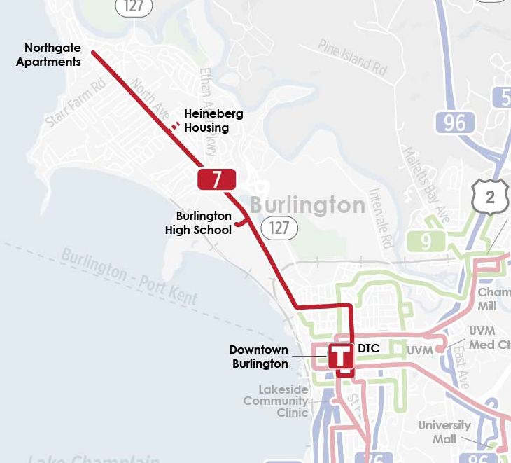
Example: Route 7 North Ave
Existing Service
  Weekdays
    5:35 AM to 10:15 PM
    Every 30 to 75 mins
  Saturdays
    6:15 AM to 7:55 PM
    Every 30 to 60 mins
  Sundays
    No service
  Ridership
    Weekdays: 841
    Saturdays: 384
    Sundays: 0

Slide 11
Example: Route 7 North Ave
TDP Recommendation
  Weekdays
    5 AM to midnight (2 AM on Fridays)
    Every 15 to 30 mins
  Saturdays
    6 AM to 2 AM
    Every 20 to 30 mins
  Sundays
    6 AM to 10 PM
    Every 30 mins

Slide 12
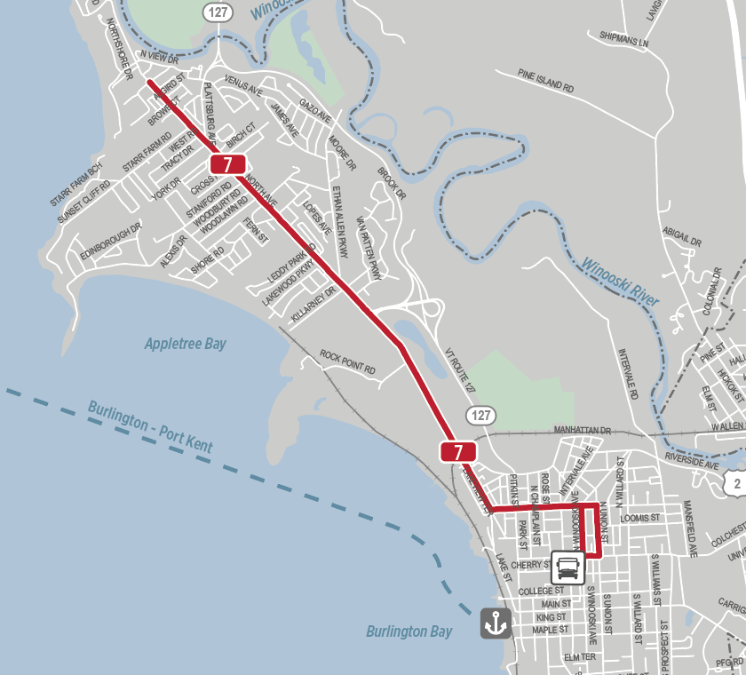
Example: Route 7 North Ave
NextGen Scenario 1
  Weekdays
    5:30 AM to 11 PM
    Every 20 to 30 mins
  Saturdays
    6:15 AM to 10 PM
    Every 20 to 30 mins
  Sundays
    7 AM to 8 PM
    Every 30 mins
  Rationale
    High demand; move toward TDP recommendation

Slide 13
Summary
TDPs
  Reflect improvements desired by wide range of stakeholders
  Are often not based on likely demand
  Do not consider costs
NextGen
  Focuses on implementable short-term improvements
  Incorporates TDP recommendations where warranted by demand
  But not fully due to cost constraints
  Does not incorporate TDP recs that:
    Do not reflect likely demand
    Involve significant capital costs

Slide 14
TDP & NeXtGen Comparison
 | CCTA TDP | GMTA TDP | NextGen
New local services | High | Medium | Very Low
New express/commuter routes | High | High | Very low
More frequent service | High | Very Low | High
Longer hours | High | Very Low | Medium
Faster service, more convenient service | -- | -- | High
Simpler Service | -- | -- | High
Fix problems with existing services | -- | -- | High

Slide 15
www.RideGMT.com/NextGen

