Slide 1
GMT NEXT GEN TRANSIT PLAN FARE ANALYSIS FINDINGS
Advisory Committee February 13, 2018

Slide 2
Presentation Contents
Existing Fare Structure
Fare Change Considerations and Methodology
Fare Free Considerations
Fare Structure Alternatives
Ridership and Revenue Impacts
Next Steps

Slide 3
EXISTING FARE STRUCTURE

Slide 4
Existing GMT Fare Structure
Very inconsistent
Single ride discount fares generally 50% of regular fare
10-ride tickets generally 9 times the price of single ride fares
County | Fare | Comment
Chittenden County Year-Round Local Commuter | Free to $1.25 $2 to $4 | Tilley Drive Shuttle and the CSS are free; all others $1.25 $2 on regular commuter routes and intra-county trips on LINK routes
Washington County Year-Round Local Seasonal Commuter | Free to $1.00 Free $1 to $4 | Most are free; four are $1.00 Mad River Valley routes $1 within the same town
Lamoille County Year-Round Local Seasonal Commuter | $1.00 Free $1 to $2 | Morrisville routes Stowe Mountain Road Shuttle $1 within the same town
FGI Counties Year-Round Local Commuter | Free to 50¢ 50¢ to $4 | $0.50 St.Albans Downtown Shuttle, Shopper is free Depending on route and distance traveled

Slide 5
Existing GMT Fare Structure
Most defining feature is lack of consistency
Urban local fares range from free to $1.25
Rural local fares range from free to $1.00
Most free, one is 50¢, four are $1.00
Commuter fares range from 50¢ to $4
Differences based on where you live, the type of commuter service, and distance traveled
Fares essentially set by route rather than by route type
No clear reason why some riders pay more and some riders pay less
Barre to Hospital Hill (via BHH DR) = free
Montpelier to Hospital Hill = $1.00

Slide 6
Other Vermont Transit Fare Structures
GMT fares in the middle range of Vermont Transit Providers
Provider | Local Service | Commuter
Advance Transit | Free | Free
Rural Community Transportation (RCT) | Free | Free
Southeast Vermont Transit | Free - $1.00 | $1.00 - $2.00
GMT | Free - $1.25 | 50¢ to $4.00
Addison County Transit Resources (ACTR) | Free - $2.00 | $4.00
Marble Valley Regional Transit (The Ride) | 50¢ - $2.00 | $2.00
Stagecoach Transportation Services | Free - $2.00 | Free - $3.50

Slide 7
Fare change Methodology

Slide 8
FARE ANALYSIS METHODOLOGY
Ridership impacts based on observed impacts at other transit systems
Used elasticities for changes with before and after fares that are greater than free
Used percentage increases and decreases in cases where fares are either now free or would be free
Fare change elasticities:
A measure that relates percentage changes in fares to percentage changes in ridership
For example, and elasticity of -0.20 means that a 1% increase in fares would produce a 0.2% decrease in ridership

Slide 9
FARE ANALYSIS METHODOLOGY
Percent increases and decreases based on changes in adult cash fare
Percent changes in discount fares are slightly different but not meaningfull
Revenue estimates based on average fares
To include impacts of discount fares
For example, if one passenger pays a full fare of $1 and another pays a discount fare of 50¢, average fare is 75¢
Estimates of changes in total revenue based on
Changes in average fares
Increase or decrease in ridership
All changes determined on a route-by-route basis

Slide 10
Fare Model Elasticities
Model 1
Average Elasticity in Service Area under 1 million people
Developed a range of estimates:
Model A: Uses a single elasticity that reflects overall impacts in service areas of less than 1 million residents
Model B: Uses elasticities for different service types but that do not consider service area size
[Note: Elasticities by service types for small urban areas not available]
Provider | Model A | Model B
Urban Local | -0.43 | -0.40
Rural Local | -0.43 | -0.50
Shuttle | -0.43 | -0.48
Commuter | -0.27 | -0.27
Express Commuter (LINK) | -0.30 | -0.30
Source: (www.apta.com/resources/reportsandpublications/Documents/Pham_Linsalata_Fare_Elasticity_1991.pdf)

Slide 11
Fare free considerations

Slide 12
Fare-free Considerations: where offered

Slide 13
Fare free considerations: market types
Existing fare free systems serve small/low ridership markets and/or specialty markets
Type of Market | Does GMT Serve this Type of Market? | Does GMT Offer Fare Free Service?
Small Urban Areas with Modest Ridership | No – Burlington area ridership more than modest | No
Large Rural Areas with Low Ridership | Yes | No
Resort Communities | Yes | Yes
University-Dominated Communities | No – Burlington has multiple universities, but student ridership does not dominate | NA

Slide 14
What are the Largest Fare-free Systems?
All are small
GMT would be largest fare free system in US
Transit System | Location | Service Area Population | Number of Routes | Annual Ridership
GoLine | Indian County, FL | 174,000 | 14 | 850,000
Hele-on Bus (free until 2011; now $2.00) | Hawaii County, HI | 174,000 | 15 | 1.3 million
North Central RTD (except two “premium” routes) | Taos, NM | 218,000 | 27 | 112.000
Green Mountain Transit | VT | 296,000 | 50 | 2.5 million

Slide 15
How Much Has Ridership Increased?
Small urban and rural systems:
32% (Lebanon, NH) to 205% (Hawaii County)
University towns:
21% (Boone, NC) to 43% (Chapel Hill, NC & Corvallis, OR)
Free fare experiments:
13% (SLC) to 86% (Topeka)
Typical:
20% to 60% increase

Slide 16
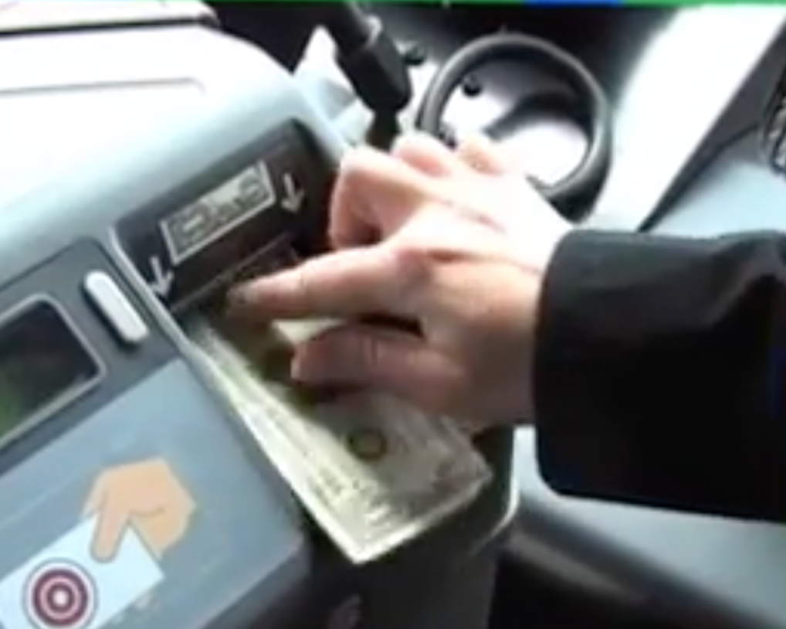
What are the Costs?
Loss of fare revenue
Reductions in costs
Cost of collecting fares
Most common reason for not charging fares is that low ridership makes fare collection not cost-effective
Increases in costs
Cost to provide more service on routes that are now at or near capacity
Costs to purchase additional buses to provide more service
(These costs would be minimal for GMT)

Slide 17
Fare structure alternatives

Slide 18
Fare Structure Alternatives
Alternatives developed by Advisory Committee:
 | Urban Local | Rural Local | Seasonal | LINK | Other Commuter
Existing | Free to $1.25 | Free to $1.00 | Free | $2.00 - $4.00 | 50¢ to $2.00
Alternative A | $1.00 | $1.00 | Free | $3.00 | $2.00
Alternative B | $1.25 | Free | Free | No change | $2.00
Alternative C | $1.50 | $1.00 | Free | No change | $2.00
Alternative D | 50¢ | 50¢ | Free | No change | $1.00
Alternative E | Free | Free | Free | Free | Free

Slide 19
Ridership and Revenue Impacts

Slide 20
Alternative A: Ridership & Revenue Impacts
Major fare changes: Reduce Urban Local to $1 and LINK fares to $3
Ridership impact: +3 to 5%
Annual revenue impact: -$255,000
 | $1.00 Urban Local | $1.00 Rural Local Free Tourism | $2.00 Commuter $3.00 LINK | Total
Chittenden County Ridership Change Revenue Change | +4 to 7% -5 to -8% | -- -- | +4 to 6% -9 to -10% | +4 to 7% -5 to -8%
Washington County Ridership Change Revenue Change | -- -- | -11 to -13% +75 to 81% | +8 to 11% -23 to -26% | -2 to -3% -15 to -17%
Lamoille County Ridership Change Revenue Change | -- -- | -2% 96% | 0% 0% | -2% -18%
FGI Counties Ridership Change Revenue Change | -- -- | -19 to -26% +49 to 63% | -4 to -5% -31 to -81% | -9 to -12% -29 to -71%
Total Ridership Change Revenue Change | +4 to 7% -5 to -8% | -9 to -11% +72 to 79% | +4.7 to 7% -24% to -29% | +3 to 5% -11%

Slide 21
Alternative B: Ridership and Revenue Impacts
Major fare changes: Fare-free on rural and seasonal routes
Ridership impact: -1.1 to -1.2%;
Annual revenue impact: $9,000 to $16,000
 | $1.25 Urban Local | Free Rural Local Free Tourism | $2.00 Commuter $4.00 LINK | Total
Chittenden County Ridership Change Revenue Change | -2% 7% | -- -- | 0% 0% | -2% +6%
Washington County Ridership Change Revenue Change | -- -- | +5 to 6% -28 to -34% | 0% -12% | +3% -13 to -14%
Lamoille County Ridership Change Revenue Change | -- -- | +2% -100% | 0% 0% | +2% -19%
FGI Counties Ridership Change Revenue Change | -- -- | +20% -100% | -7 to -10% -16 to -20% | +2 to 0% -15 to -19%
Total Ridership Change Revenue Change | -2% 7% | +5 to 6% -42 to -47% | -1.2 to -1.6% -10 to -11% | -1.1 to -1.2% +0.4 to 0.7%

Slide 22
Alternative C: Ridership & Revenue Impacts
Major fare changes: Urban Local fare to $1.50 and all Rural routes at $1.00
Ridership impact: -7 to -9%;
Annual revenue impact: $235,000 to $280,000
 | $1.50 Urban Local | $1.00 Rural Local Free Tourism | $2.00 Commuter $4.00 LINK | Total
Chittenden County Ridership Change Revenue Change | -7 to -9% 18 to 21% | -- -- | 0% 0% | -7 to -9% +17 to 19%
Washington County Ridership Change Revenue Change | -- -- | -11 to -13% +75 to 84% | 0% -12% | -6 to -7% -4 to -5%
Lamoille County Ridership Change Revenue Change | -- -- | -2% +96% | 0% 0% | -2% +18%
FGI Counties Ridership Change Revenue Change | -- -- | -19 to -26% +49 to 63% | -7 to -10% -19 to -20% | -11 to -15% -18 to -19%
Total Ridership Change Revenue Change | -7 to -9% 18 to 21% | -10 to -11% +72 to 79% | -1.2 to -1.6% -11% | -7 to -9% +10 to 12%

Slide 23
Alternative D: Ridership & Revenue Impacts
Major fare changes: $0.50 Urban Local and Rural route fare, and $1 Commuter fare
Ridership impact: +22 to 34%
Annual revenue impact: -$619,000 to -$733,000
 | $0.50 Urban Local | $0.50 Rural Local Free Tourism | $1.00 Commuter $4.00 LINK | Total
Chittenden County Ridership Change Revenue Change | +27 to 42% -34 to -41% | -- -- | +13 to 20% -14 to -16% | +27 to 42% -32 to -39%
Washington County Ridership Change Revenue Change | -- -- | -2 to 0% +32 to 36% | +4 to 6% -14% | 0 to 3% -10%
Lamoille County Ridership Change Revenue Change | -- -- | -1 to 0% +57 to 63% | +23 to 35% -33 to -38% | +3 to 5% -15 to -21%
FGI Counties Ridership Change Revenue Change | -- -- | 0% 0% | +6 to 9% -16 to -19% | +4 to 6% -15 to -18%
Total Ridership Change Revenue Change | +27 to 42% -34 to -41% | -2 to 0% +29 to 32% | +7 to 10% -23 to -25% | +22 to 34% -26 to -31%

Slide 24
Alternative E: Fare Free Ridership Increases
88% of ridership increases would be in Chittenden County
 | Free Urban Local | Free Rural Local | Free Link/ Commuter | Total
Chittenden County Increase % Increase | +837,300 +40% | -- -- | +19,737 +49% | +856,323 +40%
Washington County Increase % Increase | -- -- | +18,219 +12% | +70,448 +37% | +88,667 +25%
Lamoille County Current Projected | -- -- | +1,938 +2% | +4,896 +40% | +6,834 +8%
FGI Counties Current Projected | -- -- | +4,129 +20% | +20,604 +48% | +24,733 +39%
Total Current Projected | +837,300 +40% | +24,285 +10% | +115,685 +40% | +977,271 +37%
Note: Figures represent annual ridership; assumes 60% increase on routes with $4 fares, 40% increase on routes with fares of $1 to $2, and 20% on routes with 50¢ fare.

Slide 25
Alternative E: Ridership & Revenue Impacts
Fare changes: Fare-free
Ridership impact: +37%
Annual revenue impact: -$2,364,000
 | Free Urban Local | Free Rural Local Free Tourism | Free Commuter Free LINK | Total
Chittenden County Ridership Change Revenue Change | +40% -100% | -- -- | +48% -100% | +40% -100%
Washington County Ridership Change Revenue Change | -- -- | +17% -100% | +36% -100% | +25% -100%
Lamoille County Ridership Change Revenue Change | -- -- | +2% -100% | +40% -100% | +8% -100%
FGI Counties Ridership Change Revenue Change | -- -- | +20% -100% | +48% -100% | +39% -100%
Total Ridership Change Revenue Change | +40% -100% | +13% -100% | +40% -100% | +37% -100%

Slide 26
Summary
Ridership: Highest increases with Alternative E (fare free)
Revenue: Lowest reduction with Alternative B (free Rural Local)
 | Alternative A ($1 Urban Local; $3 LINK) | Alternative B (Rural Local free) | Alternative C ($1.50 Urban Local; $1 Rural Local (all)) | Alternative D (50¢ Urban & Rural Local; $1 Commuter) | Alternative E (Fare-Free)
Chittenden County Ridership Change Revenue Change | +4 to 7% -5 to -8% | -2% +6% | -7 to -9% +17 to 19% | +27 to 42% -32 to -39% | +40% -100%
Washington County Ridership Change Revenue Change | -2 to -3% -15 to -17% | +3% -13 to -14% | -6 to -7% -4 to -5% | 0 to 3% -10% | +25% -100%
Lamoille County Ridership Change Revenue Change | -2% -18% | +2% -19% | -2% +18% | +3 to 5% -15 to -21% | +8% -100%
FGI Counties Ridership Change Revenue Change | -9 to -12% -29 to -71% | +2 to 0% -15 to -19% | -11 to -15% -18 to -19% | +4 to 6% -15 to -18% | +39% -100%
Total Ridership Change Revenue Change | +3 to 5% -11% | -1.1 to -1.2% +0.4 to 0.7% | -7 to -9% +10 to 12% | +22 to 34% -26 to -31% | +37% -100%

Slide 27
Next Steps

Slide 28
Address Fare change considerations
What are priorities?
Reduce fares
Improve service
How much fare revenue is needed to provide desired service?
If fares are reduced, can other revenue sources be found?
How important is consistency?
How many exceptions should be made and why?
Should riders in different areas pay different fares?
(Near universal practice is to set fares based on service type and to charge same fares in all areas)
These are all policy questions that have not yet been addressed

