Slide 1
FY26 Fiscal Projections and Potential Service Impacts
Clayton Clark, General Manager
Jamie Smith, Director of Planning and Marketing
Nicholas Foss, Director of Finance

Slide 2
Agenda
Introduction
History of Urban Service
Attempts to Thwart the Financial Gap
History of Urban Financial Gap
Questions

Slide 3
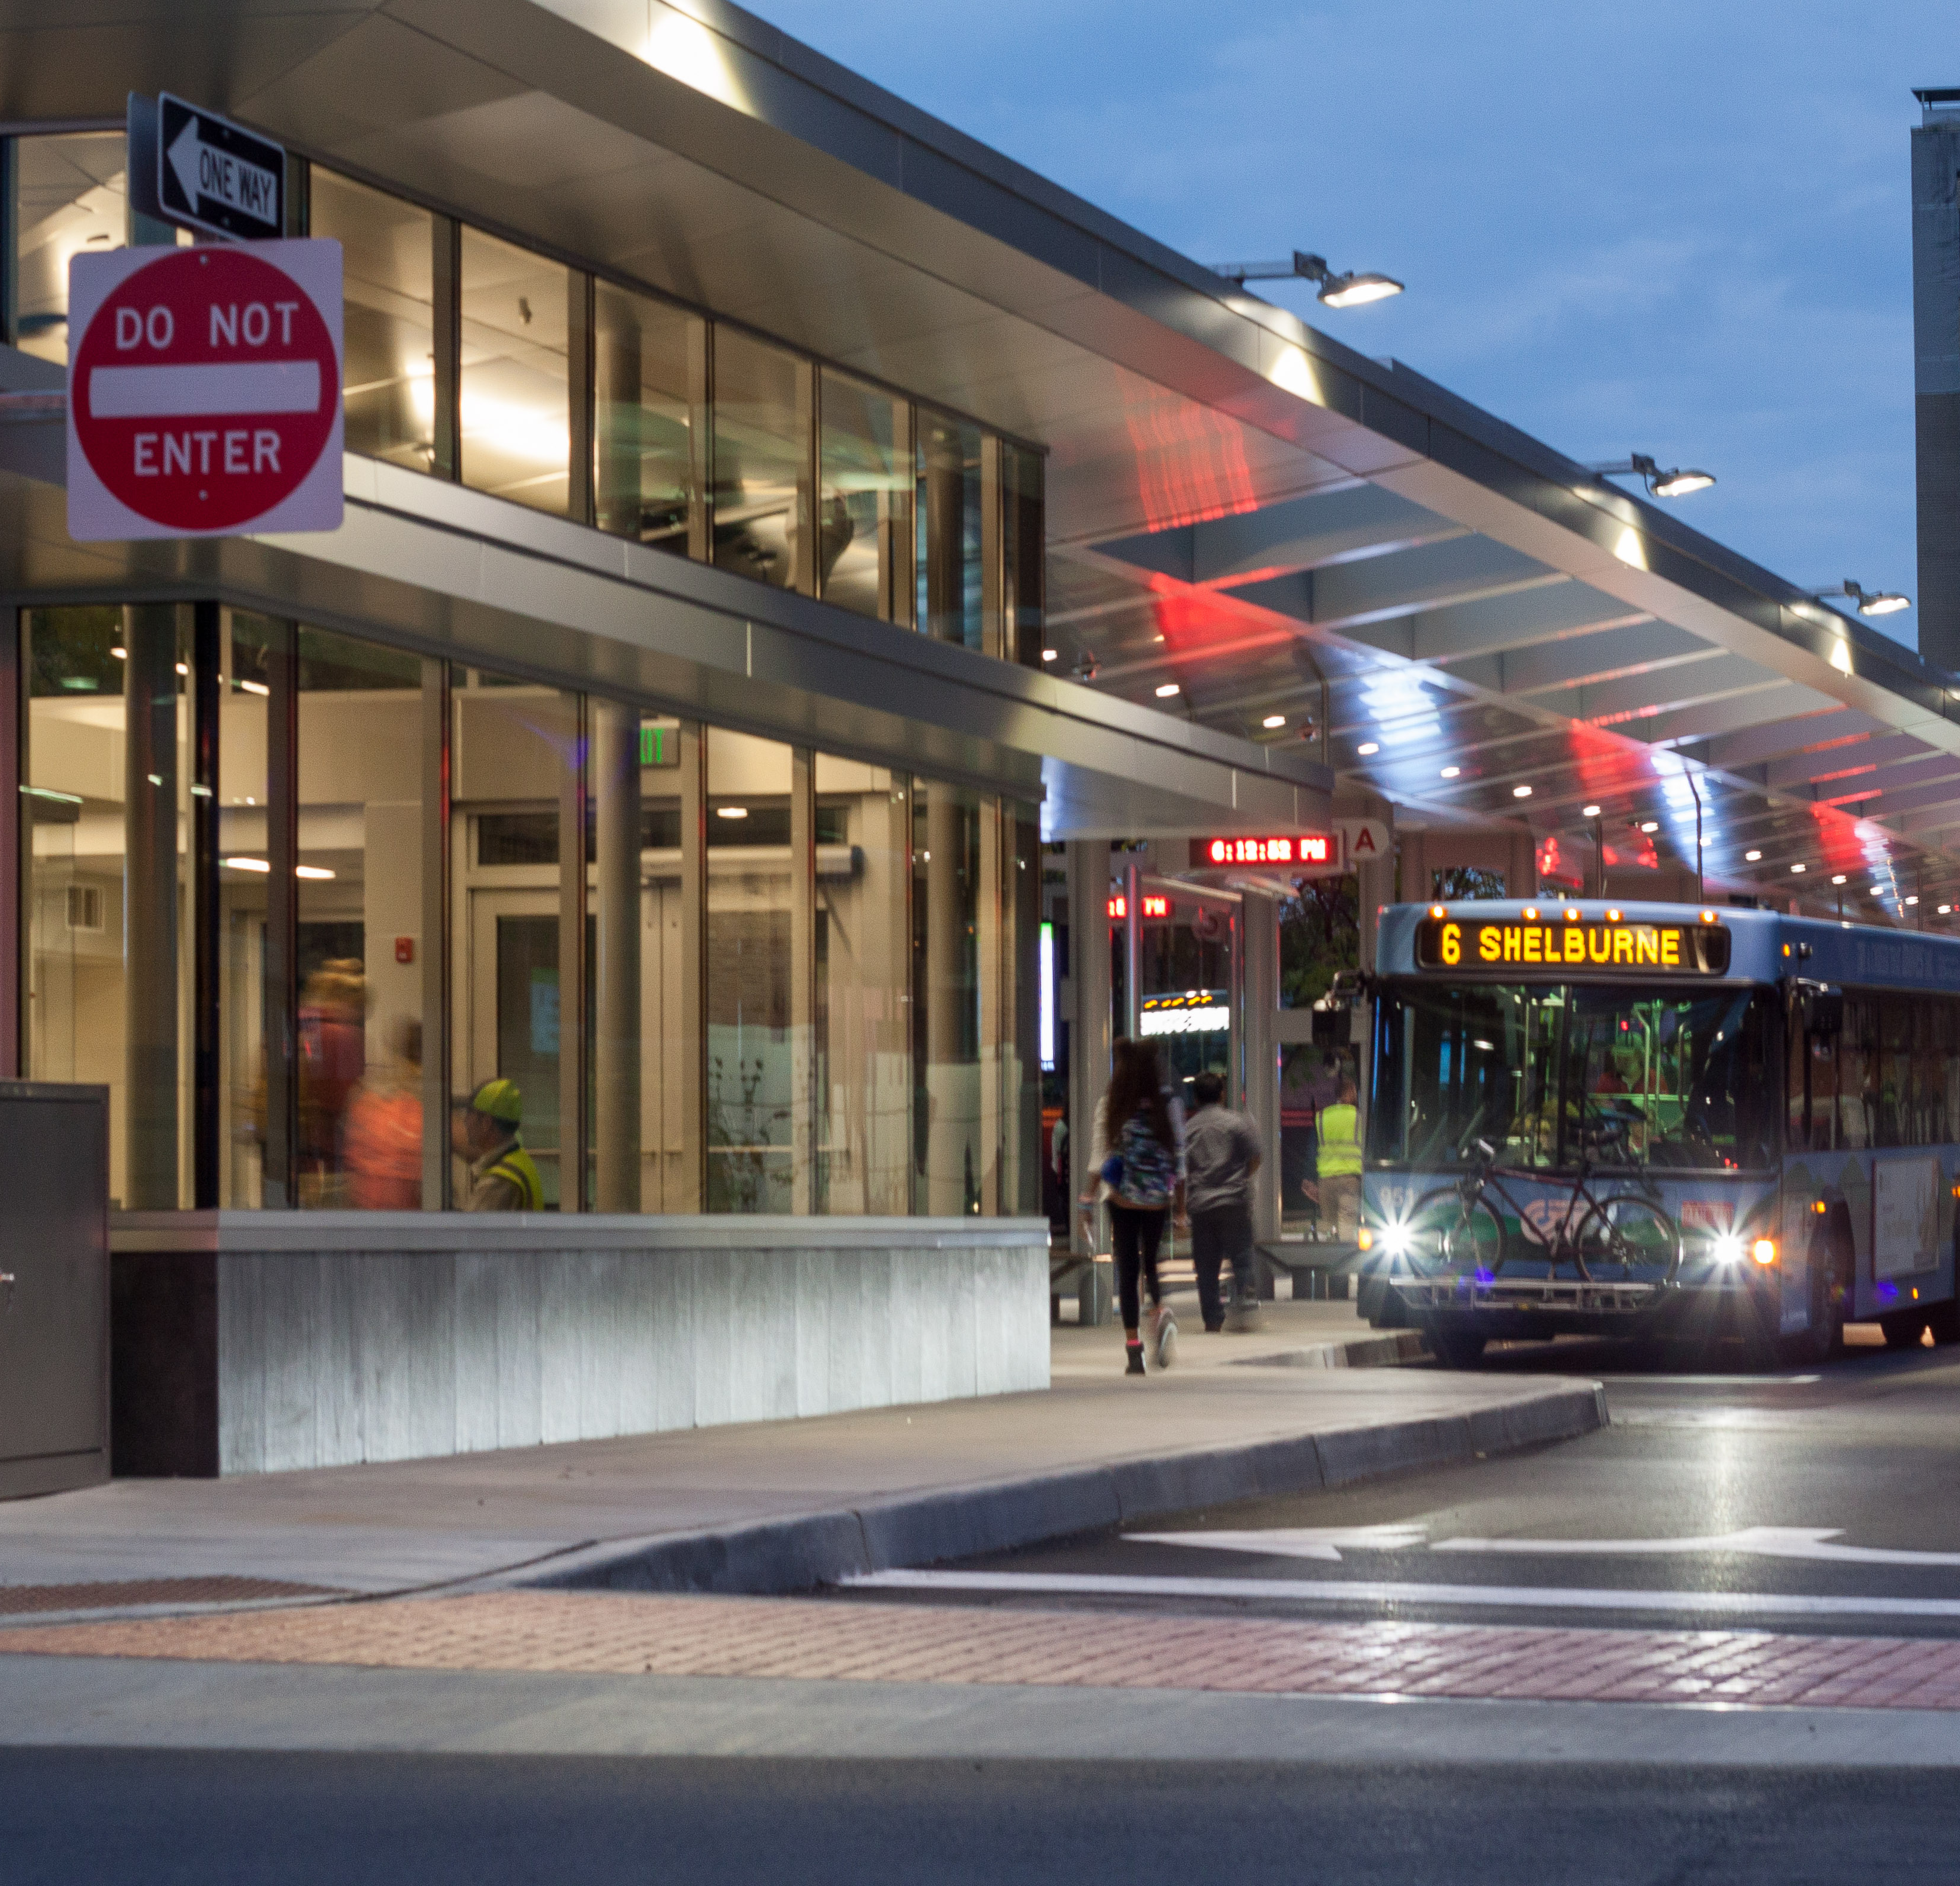
History

Slide 5
Planning Studies
In 2010, GMT (CCTA at the time) completed an urban transit development plan, which outlined service development for the next 10 years.
  Many of the identified investment areas were never implemented due to ongoing funding challenges.
    For example:
      Interregional services to Waterbury and Swanton
      Regional commuter service to Richmond
      Intermodal connection to Grand Isle ferry and Rutland Amtrak
      Parking shuttles for UVMMC and airport intercept lots at exits 12, 14, and 16
      Feeder service to trunk routes for outlying towns

Slide 6
Planning Studies
In 2018, GMT completed the NextGen study which focused on addressing issues with existing service and resources.
  The identified recommendations from NextGen were meant to be cost neutral for the organization. Once we made the service changes, we quickly realized that it was not cost neutral.
    Reasons:
      Many of the operational efficiencies identified in NextGen were not achieved due to GMT’s current method of driver scheduling.
      Some of the identified areas for reduction did not make it through the public comment process (for example: Essex Center).

Slide 7
Timeline of Service Changes
June 2019: NextGen changes implemented
February 2020: Approval to bring Williston and Essex route changes to public comment
March 2020: COVID Service Suspensions
April 2020: Approved changes to Williston and Essex. Went into effect June 2020.
February 2021:
  20-Minute Service on 1 & 2 Returns
  Kept 30-minute Midday Service on 6 & 7

Slide 8
Timeline of Service Changes
June 2021:
  Remove Colors
  Transfer Middlebury LINK to TVT
August 2021: Bring Back suspended Commuter & LINK runs
February 2022: Staff presented proposed reductions in peak service on the #6 Shelburne and #7 North Ave. plus the suspension of 4 runs on the #86 LINK Express
April 2022: The Board of Commissioners voted to restore 20-minute peak service on the #6 Shelburne and #7 North Avenue and voted to suspend two #86 LINK Express trips.

Slide 9
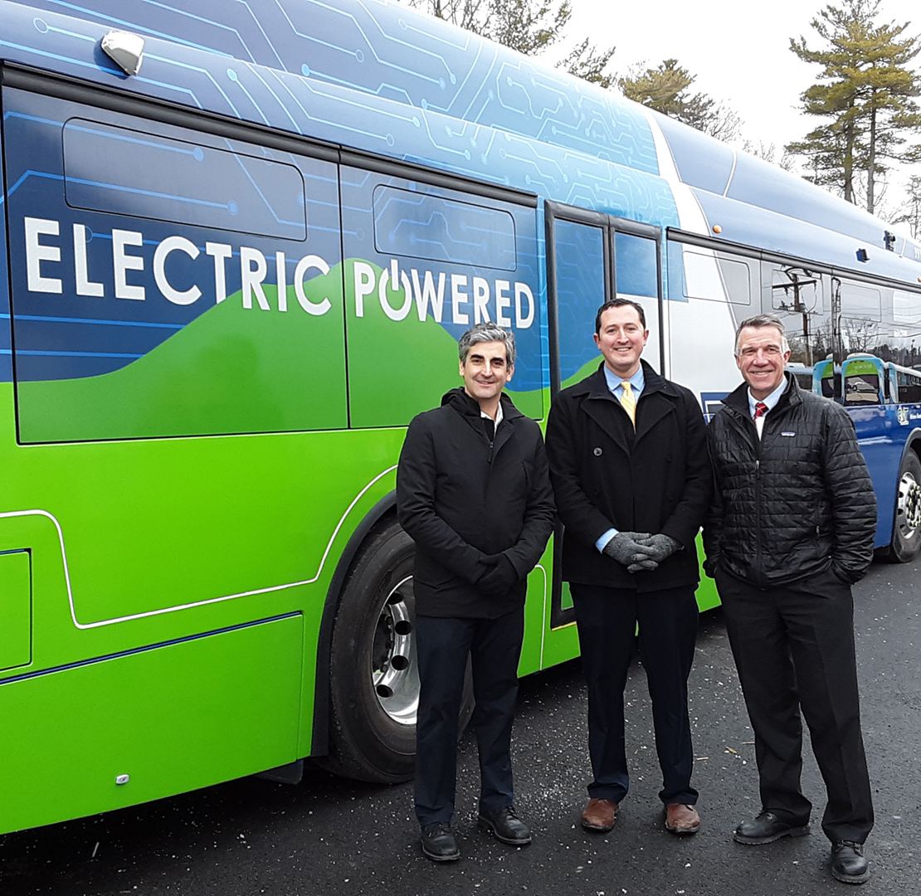
Funding
Summary

Slide 10
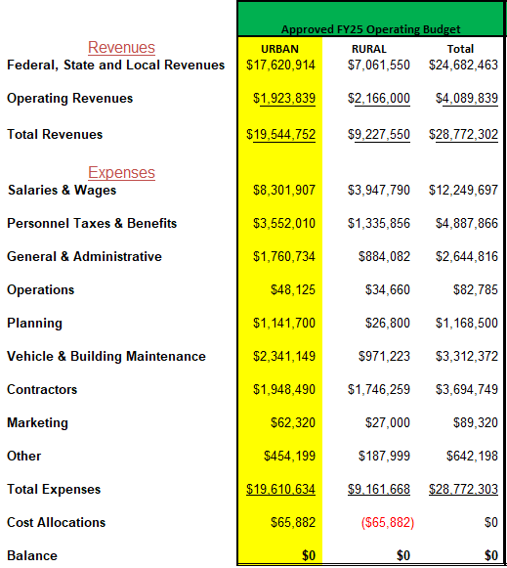
How is GMT Funded?

Slide 11
Urban Funding Snapshot
Urban system heavily dependent on federal funding
Operating revenues have declined since the pandemic
Local and State funding level unsustainable without covid-relief funds
*Based Approved FY25 Operating Budget

Slide 12
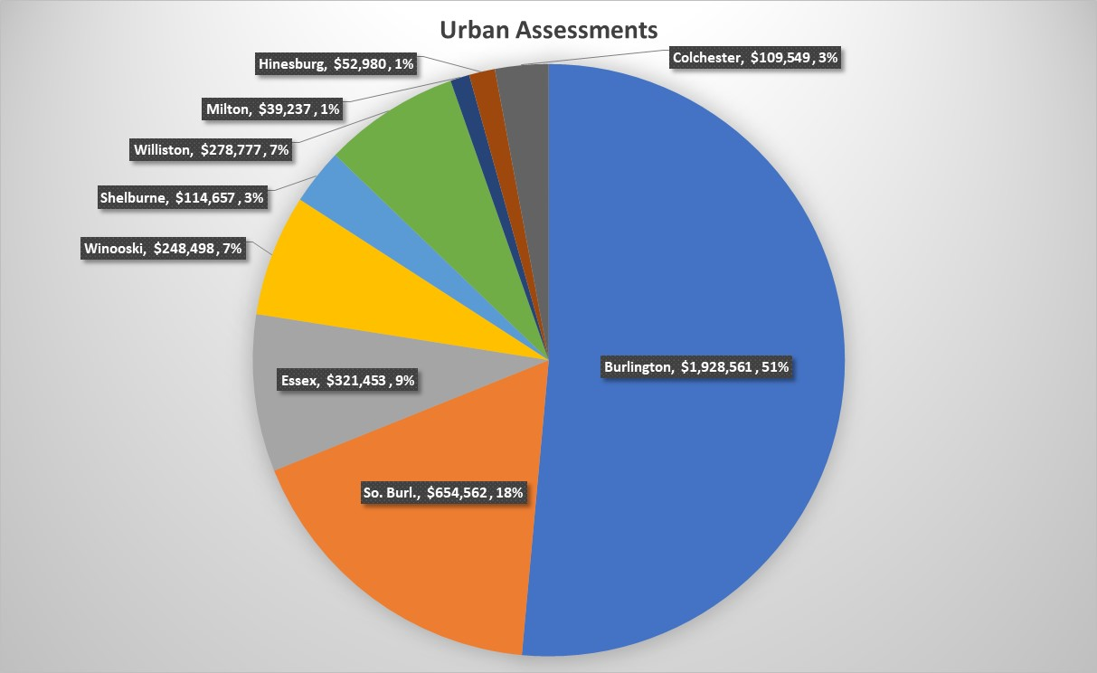
Sources of Urban Local Funding
Total Urban Local Funding = $3.8M (20%)
Total Statewide Local Funding = $4.7M
Non-GMT Local Funding = $0.9M (2.5%)*
*Based on total rural transit cost of $35.5M

Slide 13

Urban Financial Outlook

Slide 14
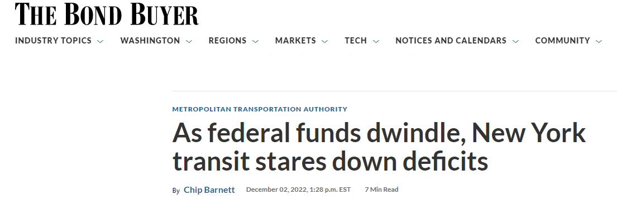
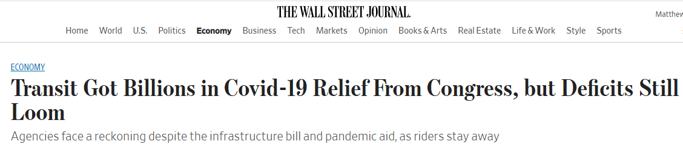
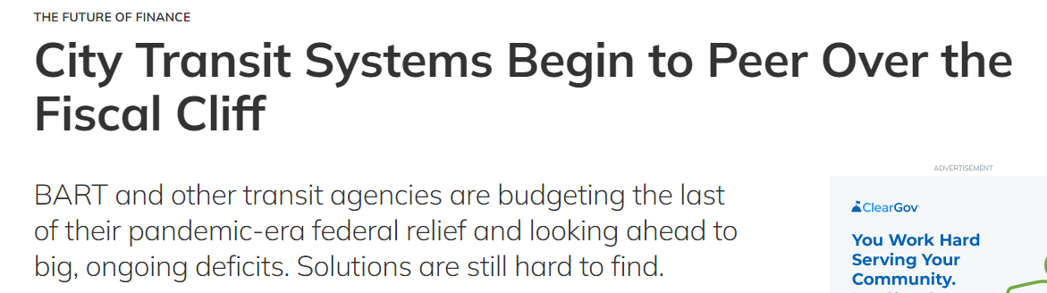
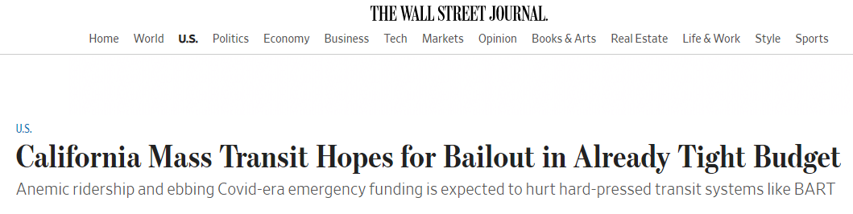
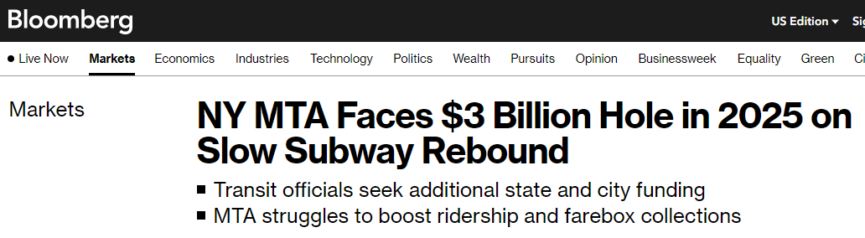
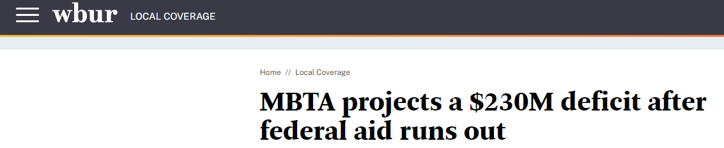
GMT is not alone…

Slide 15
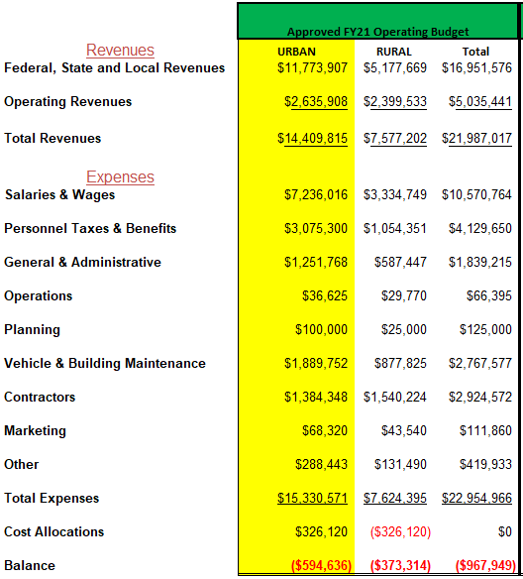
Historical Context

Slide 16
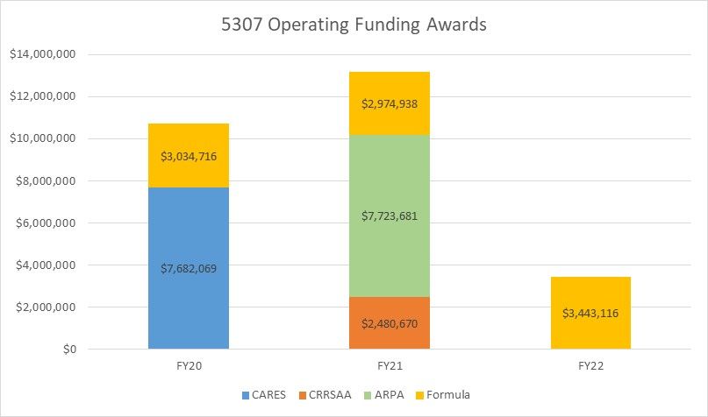
What changed? COVID-19!

Slide 17
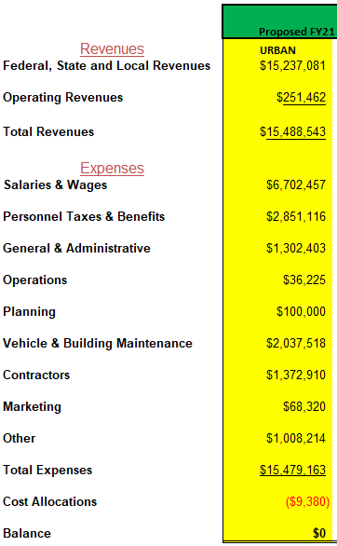
Pre-COVID
FY21 Operating Budget
Post-COVID
FY21 Operating Budget

Slide 18
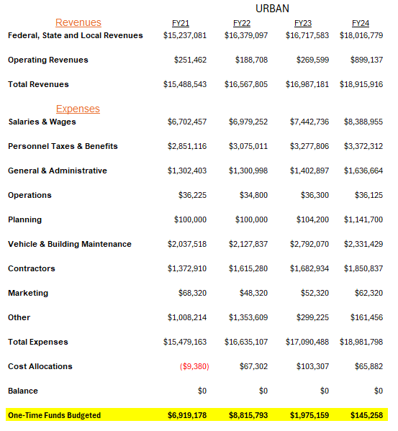
One-time Funds Only Solve Problems

Slide 19
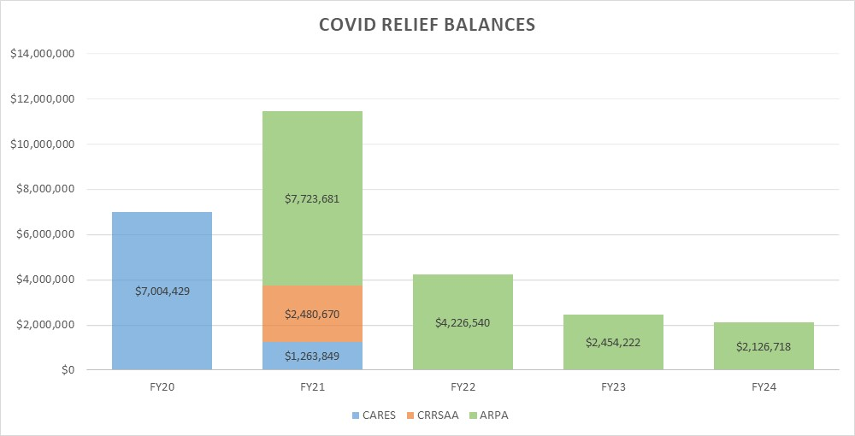
…Temporarily
All COVID-Relief Funds will be extinguished in FY25

Slide 20
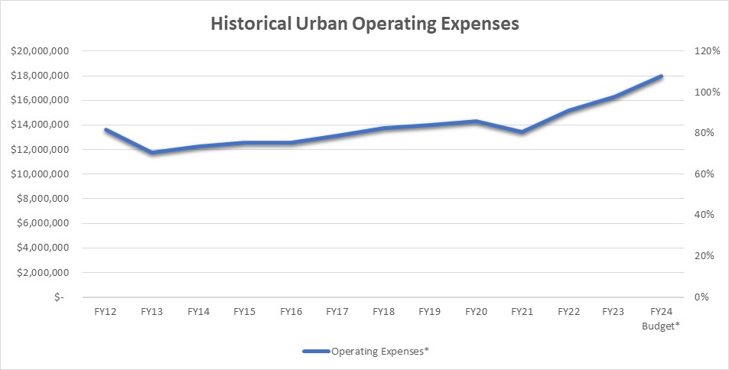
What Else Changed? Costs!

Slide 21
What Else Changed? Costs!

Slide 22
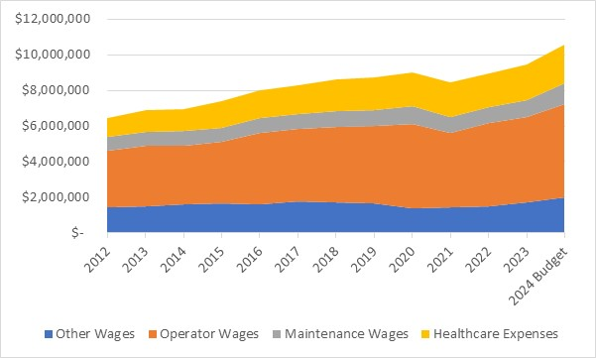
…Especially in Wages and Benefits

Slide 23
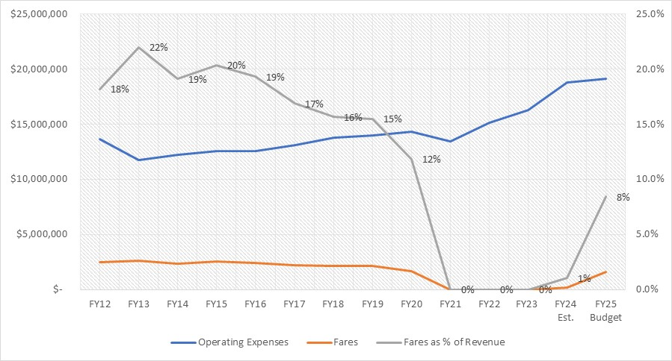
…And Fares
Operating expense growth and low fare growth has lowered farebox recovery rates
Fare-free during the pandemic has added pressure to federal funds
Loss in ridership has lowered future fare growth
10% fare target may not be sustainable

Slide 24
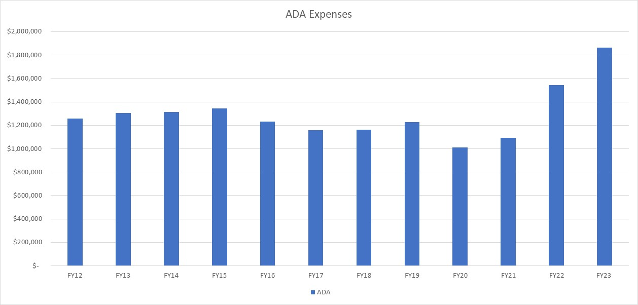
ADA Costs Have Increased

Slide 25
How Do We Move Forward?
COVID Funds remain to support current service levels for FY25
1
Initial forecasts predict a $2.7M deficit in FY26 at current service levels
2
If new revenues are not identified, service levels could need to be reduced by as much as 29%
3
GMT needs a sustainable funding model to ensure the viability of transit in Chittenden County

Slide 26
Thank you. Questions?
To offer additional comment, contact:
Clayton Clark, cclark@ridegmt.com
Jamie Smith, jamie@ridegmt.com
Nick Foss, nfoss@ridegmt.com

