Slide 1
GMT NEXT GEN TRANSIT PLAN OVERVIEW OF PARATRANSIT SERVICES
NOVEMBER 14, 2017

Slide 2
Overview of PARATRANSIT services:
Urban | Service Provider
Chittenden County | SSTA
Rural | Service Provider
Washington County | GMT
Franklin County | GMT
Grand Isle County | CIDER

Slide 3
EXISTING CONDITIONS (FY 17)
County | How Provided | General Public* | ADA | E&D | Medicaid | Total
Chittenden | Contract with SSTA | N/A | 41,529 | 18,445 | SSTA=broker | 59,974
Rural Counties | GMT in Washington and Franklin Counties Contract with CIDER in Grand Isle County | 4,517* | 0 | 25,746 | 63,543 | 93,806
All Counties |  | 4,517 | 41,529 | 44,191 | 63,543 | 153,780
Mode Break-up in Rural Counties
 | Paratransit |  | Volunteer | Taxi | Mileage Reimbursement | Bus Pass | Total
 | Van | Sedan
E&D | 12,628 | 48 | 12,245 | 442 | 4 | 379 | 25,746
Medicaid | 35,921 | 62 | 22,378 | 1,955 | 3,174 | 53 | 63,543
Total Paratransit Ridership: 94,705 *Routes 79, 90, and 91

Slide 4
Urban paratransit service: Ssta
GMT contract with SSTA for turn-key services (ADA & E&D)
SSTA also operates on demand responsive shuttle called Tilley Drive Shuttle (very low ridership)
5 year contract expires June 2019
SSTA also is Medicaid broker for in Chittenden County: some co-mingling of trips
SSTA’s ADA Paratransit Service - Observations
Service performance is meeting service quality standards.
Recent customer satisfaction survey: high satisfaction
Inconsistent reservation hours (contract vs. customer materials)
Inconsistent same day trip policy (staff vs. customer materials)
Hour by hour hold statistics available, but not reported
No set standard for longest hold time
Staff unsure about screening of conditionally-eligible trip requests
Excessively long trip checks should be expanded to include some shorter-distanced trips
ADA-related complaints not tracked separately; resolutions not documented, response not tracked; patterns not assessed
No PAFR standard nor a related incentive or penalty in contract
Definition of productivity standard in contract unclear
Trips per mile standard in paratransit has little value
Notes:
The first is 60 minutes as a scheduling parameter in RouteMatch. This means that RouteMatch’s batch scheduling and optimization routines will not purposely schedule a trips with ride time over 60 minutes. This is not to say that a scheduler or a dispatcher might do this manually; there is nothing but a warning that will alert the scheduler or dispatcher that the maximum ride time standard is being exceeded when they manually schedule a trip.
The second, from the contract, says that “ride times shall not be more than 15 minutes longer than similar rides on the fixed route, taking into account a reasonable amount of time to travel to and from a bus stop, plus travel time on the fixed route.”
The FTA requires transit agencies to ensure that there is not a pattern of excessively long trips. From a practical standpoint, GMT already checks this on a monthly basis by using Google Transit to compare all trips that do exceed 60 minutes with the origin to destination time of a transit customer making the same trip on transit.

Slide 5
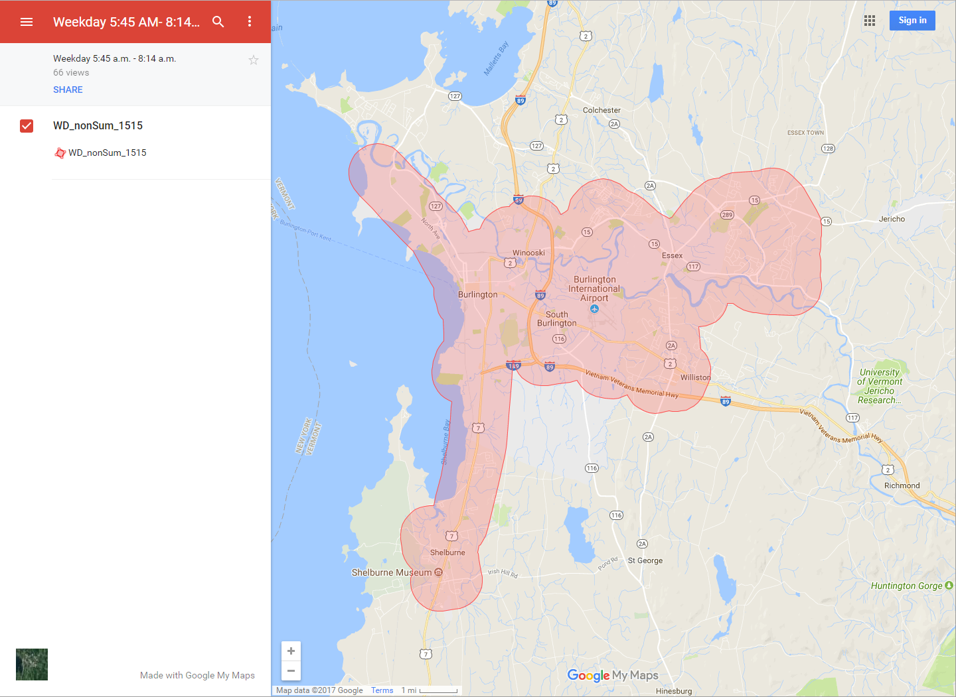
Urban ADA paratransit service
Notes:
The first is 60 minutes as a scheduling parameter in RouteMatch. This means that RouteMatch’s batch scheduling and optimization routines will not purposely schedule a trips with ride time over 60 minutes. This is not to say that a scheduler or a dispatcher might do this manually; there is nothing but a warning that will alert the scheduler or dispatcher that the maximum ride time standard is being exceeded when they manually schedule a trip.
The second, from the contract, says that “ride times shall not be more than 15 minutes longer than similar rides on the fixed route, taking into account a reasonable amount of time to travel to and from a bus stop, plus travel time on the fixed route.”
The FTA requires transit agencies to ensure that there is not a pattern of excessively long trips. From a practical standpoint, GMT already checks this on a monthly basis by using Google Transit to compare all trips that do exceed 60 minutes with the origin to destination time of a transit customer making the same trip on transit.

Slide 6
E&D Partners- Chittenden County
Cathedral Square Senior Living and Holy Cross
CVAA
CVAA/countywide: no restrictions on origins/destinations
Champlain Senior Center
City of Winooski
Milton Family Center
Colchester
Hinesburg
Richmond
Williston
VNA

Slide 7
GMT PARATRANSIT SERVICES in Washington CO. & franklin CO.
Paratransit service operated for E&D, Medicaid NEMT and general public trips (Routes 79, 90, 91 in Washington Co only) by GMT
GMT provides all call center/operational functions and assets (vehicles, software, tablets, telephone, etc.)
Call center (reservations/scheduling) functions located in Burlington
Operations/dispatch functions in Berlin and St. Albans
Paratransit fleets
Washington Co: 12 vehicles providing E&D or NEMT (or both) or GP
Franklin Co: 8 vehicles providing E&D or NEMT (or both)
Notes:
Do the runs of E&D, Medicaid and comingled in both the Washington and Franklin County need to be added?

Slide 8
GMT PARATRANSIT SERVICES in grand isle
CIDER provides E&D paratransit and Medicaid NEMT services under contract to GMT
CIDER performs all functions and supplies most of the assets (except for software supplied by GMT)
Currently has a total of 7 vehicles

Slide 9
RURAL PARATRANSIT - OBSERVATIONS
Most ADA paratransit needs are being met through route-deviation services; however….
GMT should be providing ADA paratransit for:
Washington County
Route 85, Hanover Shuttle (Tuesday only)
Route 87, Northfield Community Shuttle (Wednesday only)
Route 89, City Commuter – local bus service

Slide 10
Performance stats
SSTA: Ridership Trends (2012-17)
FY | ADA | E&D | Tilley Drive | Total | % Change
2012 | 52,792 | 18,355 | 594 | 71,741 | 9.8%
2013 | 53,363 | 15,782 | 562 | 69,707 | -2.8%
2014 | 54,890 | 16,232 | 858 | 71,980 | 3.2%
2015 | 55,229 | 16,518 | 685 | 72,432 | 0.6%
2016 | 45,732 | 16,999 | 684 | 63,415 | -14.2%
2017 | 41,529 | 18,445 | 590 | 60,564 | -4.7%
16% since 2012
Performance Statistics:
Measure | Urban
On-time Performance(OTP) | 96.5%
Productivity | 1.93
Cost/Trip | $45/trip

Slide 11
Recommendations – urban
Call center (SSTA and GMT):
Consistency of reservation hours
Denial documentation
Clarification on same-day trip request policy
Average hold times:
GMT should require SSTA to send hour-by hour reports for each day of the month
GMT should require that no calls should have a hold time over 5 minutes
Differentiate between hold time for reservations vs. trip status/ETA calls
Require tracking/reporting of average hold time and maximum hold time for each hour for the reservation period for each day of the month
Trip eligibility check:
Confirm SSTA screening of conditionally-eligibility trip requests

Slide 12
Recommendations - urban
Automatic triggering of arrival calls based on real-time location
Implement no-show tracking (and differentiate no-shows from missed trips)
Add short-distance trips to excessively long (in duration) trip checking and add a not to exceed standard
Complaint management:
Should establish a database for tracking complaints and GMT’s response
A reasonable standard time period for responding should be established
Complaint reports should include the number and percentage of responses that exceed standard, as well as complaints by type
Complaints by type should be assessed for patterns that may point to possible capacity constraints

Slide 13
Recommendations - urban
Safety:
GMT should establish a PAFR standard of 1.0 preventable accidents for every 100,000 total miles
Productivity:
Tracking of a ADA vs. E&D productivity is meaningless; a combined overall productivity is appropriate
Clarify which trips are used to define productivity
A mileage based productivity standard can be stripped from future contracts
Subscription Trip Percentage:
A standard for a minimum subscription trip percentage or a minimum sedan trip percentage is not meaningful and can be stripped from future contracts

Slide 14
Recommendations - rural
ADA paratransit obligation should be met for existing and future local fixed route (non-deviation) services
New ADA paratransit trips to the service can probably be handled by GMT’s current paratransit fleet – ADA trips can be co-mingled with E&D and NEMT trips
E&D trips would likely continue to funded through 5310 funds – GMT will need to establish a policy for dually-eligible trips
If new ADA paratransit trips outstrip current supply of paratransit service, resources will need to be added
Based on $69 / hour, each additional vehicle run, operating between 10 and 12 hours/day x 6 days per week x 50 weeks/year (excludes holidays) would cost between $207,000 and $248,000
Notes:
Utility runs that accommodate E&D and Medicaid trips, can also accommodate new ADA paratransit trips.

