Slide 1
Transit Futures: PTPP – Section 20 – COVID-19
GMT Board
May 11, 2020
Stephen Falbel Steadman Hill Consulting

Slide 2
Overview
Public Transit Policy Plan
10-year vision covering all of Vermont
Completed in February 2020
Section 20 Report
Commissioned by legislature in 2019 session
Focuses on methods of increasing transit ridership
Completed in January 2020
COVID-19
What are the short- and long-term implications of the pandemic for GMT?

Slide 3
Policy Planning in Vermont
State law requires policy plans for all transportation modes to be updated every five years
The federal government requires a human service transportation coordination plan to be updated every four years
For public transit, VTrans combined these efforts into the 2020 Public Transit Policy Plan

Slide 4
Project Tasks
Summer-Fall 2018
Project
Initiation
Winter
2019
Existing Conditions analysis
Winter-Spring 2019
Needs assessment
Summer
2019
Recommendations
&
Implementation
Winter
2020
Final Report
Public/Stakeholder Outreach
Notes:
The project tasks

Slide 5
Primary Needs Identified
Lack of transit access in rural areas
Lack of resources to meet the needs of vulnerable populations both today and in the future
Lack of transportation for access to jobs
In areas that have bus routes, improved service levels and connections are needed

Slide 6
Critical Themes and Challenges
Aging population
Economic trends and opportunities
Technology and information
Public awareness
Land use and housing location

Slide 7
Key Aging Statistics
Average age of Vermont residents: 42.6 years
Third highest in the US, behind Maine and New Hampshire
In the next 10 years, the number of Vermonters over 65 will increase by 60% to 175,000 people
Fastest growth will be in those over age 80
Some of the most rural counties have the highest percentages of older adults
Essex
Bennington
Windsor
Orleans

Slide 8
Policy Challenges – Aging
Helping older adults make informed choices
Age in place or move to a location with easier access to services?
Keep driving until it is no longer possible or begin transition to using public transit?
Allay fears about future mobility
Engage as a volunteer driver
Learn about existing options
Help to build community support for expanded service

Slide 9
PTPP Strategies – Aging
Create working committee with Agency of Human Services to address mobility issues for older Vermonters
More comprehensive planning for Elders and Persons with Disabilities Transportation Program
Set up annual statewide meeting with work plan
Share best practices: coordination, low-cost trips, volunteer management
Establish Personal Mobility Accounts
Expand Ticket To Ride statewide
Allow for deposits, gifts and possibly ride credits

Slide 10
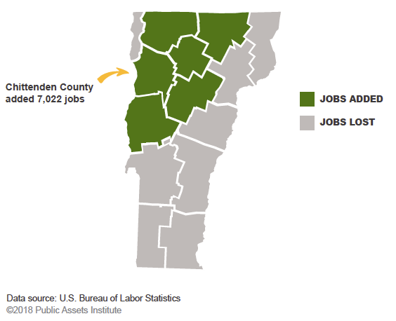
Economic Trends & Opportunities
Job growth in the past decade restricted to Northwest and Central Vermont
Chittenden County accounts for a third of all jobs in Vermont and half of new jobs created since 2008

Slide 11
Public Transit and Employment
In urban areas, transit can allow for economic growth without building more roads and parking and can reduce congestion
In both urban and rural areas, transit can provide access to jobs for people who cannot drive
In rural areas, transit may be the only mobility option for people who cannot afford a car
Access to jobs identified as one of the primary themes during the needs analysis from both employer and employee perspectives

Slide 12
PTPP Strategies – Employment
Increase awareness of carpool/vanpool options through Go Vermont
Enlist support of employers in new JobRides program
Create “late bus” for shift workers
Expand partnership with Good News Garage
Consider partnerships with Uber/Lyft, volunteer groups, where available

Slide 13
Technology and Information
Multiple impacts on public transit
Real-time information for passengers: Where’s my bus?
Operational management for transit agencies reliability
Mobility on demand, more flexible trip planning
Ride-hailing services
Limited impact outside of Chittenden County thus far
How do they integrate with other public transit?
Challenges
Not everyone has a smartphone
Cellular access/broadband not universally available

Slide 14
PTPP Strategies – Technology
Create new paradigm for demand response service
Work with microtransit companies for software
Multi-program integration (Medicaid, E&D, client-pay, etc.)
Multi-resource integration (vans, taxis, volunteer drivers, bus routes, TNCs)
Use expanded volunteer driver pool as a resource statewide
Link to Personal Mobility Accounts

Slide 15
Public Awareness
Depends on geography
High awareness in Chittenden County
Lower awareness in rural areas
Depends on age, income and disability
Those who can drive don’t think much about transit
Depends on the type of service
Local and commuter bus routes more visible
Rural services run less frequently, less visible
Volunteer driver services may be totally invisible

Slide 16
PTPP Strategies – Awareness
Continue investment in Go Vermont
Expand capabilities
Increase marketing
Create interactive map of bus routes
VTrans-sponsored project to document stories of the value of public transit
Video and audio interviews with beneficiaries
Could be used at Town Meetings and elsewhere
Continue/expand partnerships and activities
Partners include AARP, State agencies, elected officials, Community Transportation Association of America (CTAA), Vermont Public Radio/Television

Slide 17
Land Use and Housing Location
60% of Vermonters live in areas classified as rural
Average population density is 68 people per square mile
Lowest density: Northeast Kingdom - 32
Highest density: Chittenden County - 299
Vermont has one urbanized area (Burlington) and 19 “urban clusters” with 2,500-50,000 people each

Slide 18
Policy Challenges – Land Use
Traditional bus routes viable only in areas with high enough density – 3 households or 4 jobs per acre
Safe, comfortable and accessible pedestrian environment is essential to public transit routes
Sidewalks, crosswalks, safe places to wait for the bus
Obstacles to compact development
Lack of infrastructure (water and sewer) capacity
Zoning bylaws and local opposition
Reliance on private-sector initiatives to build housing
Coordination with commercial/retail development

Slide 19
PTPP Strategies – Transit-supportive development
Continue to work with District Commission staff and RPCs to ensure that, as applicable:
Transit providers are engaged in the development review process.
Multimodal connectivity is considered in both Act250 and the local development review process.
Work with state, regional and local agencies to integrate transit into land use planning
Density
Location
Accommodations
Promote objectives from Long Range Transportation Plan
Maintain and strengthen the vitality of Vermont’s villages and downtowns.
Make transportation investments that promote active transportation and reduce social isolation.

Slide 20
Climate Change
When bus routes are available, fill them up with riders
Electrify the transit fleet
Award priority scoring to proposed fixed service transit routes that serve Downtowns and Villages
Continue to support the Vermont Planning and Development Act (24 V.S.A. § 4302)
Making trips shorter by moving people closer together
Allows for more walking trips
Promotes more people sharing the same vehicle
Reduces the number of miles travelled by vehicles

Slide 21
What did Vermonters Think?
PTPP included extensive outreach process
11 regional forums
3 advisory committee meetings
9 stakeholder interviews
9 E&D Committee assessments
Numerous other presentations
Appearance on VPR’s Vermont Edition
Project website
Two online surveys
First round (Fall 2018) on needs: 1,200 responses
Second round (Summer 2019) on strategies: 2,200 responses

Slide 22
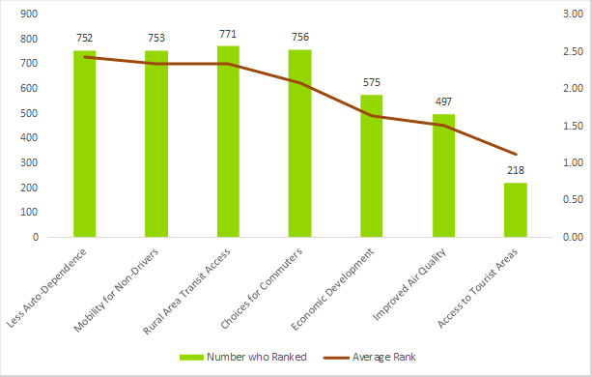
Policy Ranking

Slide 23
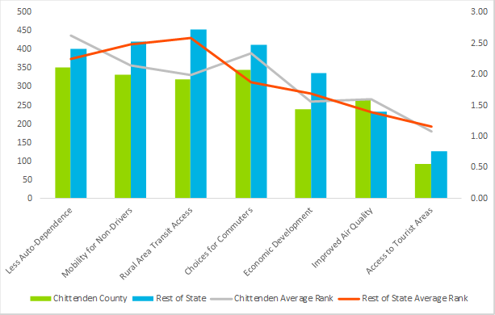
Chittenden Cty. vs. Rest of State

Slide 24
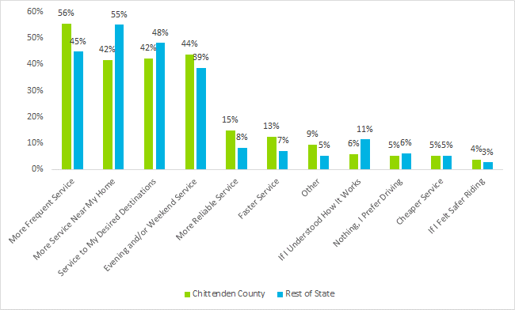
Potential Improvements

Slide 25
Budgeting Activity

Slide 26
Transit Funding Options

Slide 27
Section 20 Study (H. 529)
Goals of the study
Study methods to increase use of public transit
Special emphasis on rural areas
Examine the benefit of providing local connectivity to transit
Evaluate what factors affect public transit ridership in Vermont
Products of the study
Most effective improvements in service and criteria to use to determine the priorities of investments
Estimated funding necessary to achieve the improvements

Slide 28
Literature Review
Reviewed 11 national and international studies
Transit Cooperative Research Program
University Transportation Centers
Industry journals
Community Transportation Association of America reports
Conference proceedings
Key topics
Ridership growth in rural areas
Impacts of Transit Intelligent Transportation Systems (ITS)
Internal vs. external factors affecting ridership

Slide 29
NCHRP Report on Best Practices
Strengthening community awareness and marketing transit service remains a critical part of attracting new riders.
Successful rural transit agencies actively manage their services.
“Old tricks” like regional connecting services, university pass programs, and free ride days are still important strategies.
“New” ideas and technologies are creating opportunities to grow rural transit ridership.
Partnerships are an essential part of successful rural transit services.
Transit agencies can maximize efforts to increase ridership by doing all of these things.
State support also essential

Slide 30
Analysis of Vermont Services
Looked at highest performing routes
Total ridership
Highest productivity (riders per unit of service)
Identified characteristics of each associated with high performance
Then looked at underperforming routes
Low ridership
Low productivity
Identified factors limiting their success

Slide 31
Urban High Performers
Successful route | Ridership | Productivity | Characteristics
College St Shuttle |  |  | Free fare; wholly within dense area; high frequency (every 15 min)
Essex Junction |  |  | Major commuter corridor; Fort Ethan Allen; UVM MC; 15-min peak service; high parking charge at destination
North Ave |  |  | Highly linear/few alternatives; dense development; high parking charge at destination
Riverside/Winooski |  |  | Dense development for whole route; tailored service (less during off-peak); serves low-income area
Williston |  |  | Serves major traffic generators (downtown, UVM, Taft Corners and UMall)
=high performer; =moderately high performer

Slide 32
Conclusions: High Performance
High productivity is often a function of limited or targeted service
Only the best transit corridors have high productivity with a high level of service
High ridership related to several factors
Major trip generators
Dense and continuous development
Frequent and direct (time-competitive) service
In Vermont, ski areas and universities are keys to transit success
Low/free fares and rider subsidies also important factors

Slide 33
GMT Low Performers
Successful route | Ridership | Productivity | Characteristics
GMT Sunday Service |  |  | Limited service; circuitous routing; Sunday demand
GMT Williston/Essex |  |  | Low service level; lack of continuous development; free parking at both ends; poor walking environment in Williston
GMT Capital Shuttle |  |  | Limited demand in non-legislative season; overlap with Montpelier Circulator
=poor performer; =moderately poor performer

Slide 34
Conclusions: Underperformers
Small towns and villages may have mobility needs but still not generate enough demand to support a traditional bus route
Low service levels not attractive to residents who can drive
Pedestrian facilities poor or nonexistent in many non-urban areas
Commuter routes face uphill battle in era of low gasoline prices
Confusing/poorly designed schedules can be a barrier
Capital investment also critical to attract choice riders, but hard to justify in low-density areas
Shelters and lighting
Cutaways can be a disincentive

Slide 35
Why increase ridership?
Make more effective use of existing resources
“Fill those empty seats”
Address the unmet needs for mobility
Health, job access, life necessities, social interaction
Reduce energy use and GHG emissions
Reduce congestion and wasted time
Free up resources used on automobiles including land used for parking and a lot of money

Slide 36
Methods – Short Term
Improve local access connections
Partnerships with employers, institutions, community orgs.
Marketing campaign to change image of transit
Tied to climate change, health, freedom, etc.
Incentives to ride
Further investment in technology and information
Capital investments in vehicles and passenger amenities
Higher levels of service where density warrants

Slide 37
Methods – Longer Term
Sidewalks, streetscape, bicycle facilities
Planning: actively managing transit service
Land use
Transit-oriented development
Infill housing
Growth in town and village centers
Paradigm shift in demand response transit

Slide 38
Policy Levers
Changing the competitive balance between driving and transit
Parking, parking, parking
Availability
Location
Pricing
Fuel prices/taxes
Fare free transit
Total fare revenue for all rural operations in VT: $522K
Total fare revenue in Chittenden County: $2.2M

Slide 39
Fare Free Transit
TCRP Synthesis 101 – Implementation and Outcomes of Fare-Free Transit Systems
“Commuters in private vehicles are not attracted in large numbers to fare-free public transit.”
5% to 30% of new riders formerly used other motorized mode
Most new trips made by existing riders using system more
Most new riders formerly pedestrians/cyclists or people who would not have made the trip otherwise

Slide 40
Corvallis (OR) Transit System
City agency serving 55,000 residents, including 20,000 OSU students
Students comprise 43% of all ridership; faculty staff 4%
Were already riding fare free through a UPass program
Students paid $2.76 fee per term
Cash fares were $330K; 14% of $2.4 million budget
10 routes, 60-min headways, carried 2,100 passengers per day
Converted to fare free in 2011
Fare revenue replaced by monthly fee on utility bills
Individual household as little as $2.75 per month
Large businesses up to $1,000 per month
Cash fares and student fees were eliminated
Also replaced local property tax funding for transit

Slide 41
Corvallis Results
First month, ridership increased 24%, second month 43%; total increase for the year was 38%
Expected issues with homeless people, but none materialized
Transit Operations Fee
Currently $3.16/month for single family residential customers
$2.18/month for multi-family residential customers
Much higher for commercial and industrial customers
Based on ITE Trip Generation rates
Generated $925,000 in FY2018
Total ridership in FY19: 1.08 million, over 3,000 per day

Slide 42
Comparison to GMT Urban
Burlington UZA population larger (108,000) and student population smaller (about 15,000)
GMT not a city agency, does not control utility bills
GMT Urban fare revenue about $1.6 million (not including Unlimited Access revenue ~$588K)
GMT local assessments about $3.2 million

Slide 43
Conclusions on Fares
Making all rural service fare free not infeasible, but likely would not increase ridership by a significant amount
Density and level of service are more important factors
Many rural routes are already fare free or low fare
Removing fares from GMT Urban service…
Would likely increase ridership significantly
More use by existing cash fare riders
Improved mobility for those who cannot afford the fare
Substitute for walking and biking trips
Would leave a large hole in the budget
Would not have a large impact on traffic

Slide 44
Overall Conclusions
Ridership can be increased through investments
Planning, marketing/information, capital, service
At best, incremental increases would be expected
In longer term, land use can make a big difference
Major shifts only result from “big” changes or a “crisis mentality”
Significant policy change regarding parking
Substantial increase in fuel prices
Attention-grabbing change in climate

Slide 45
Our Current Crisis
Starting in mid-March, fifty years of consistent messaging encouraging transit and ridesharing came to a halt
Instead of encouraging people to share rides, we had to be discouraged from being close to others
Only riders left on transit vehicles were those who had no other mobility options and
Who cannot work from home
Who are essential employees
Who need to travel for basic necessities

Slide 46
Impact on Transit
Ridership down significantly
Demand response ridership down 72% compared to same period last year
Bus route ridership down about 70%
Routes that serve shopping areas down less (about 50%) than commuter-oriented routes
GMT weekday ridership down 73%, but weekend ridership down only about 55%
Service reductions
Many routes suspended or replaced with demand response service
Statewide about 50% fewer service hours in operation
Fare free service on GMT

Slide 47
After the Pandemic
How long is the transition back to ”normal”?
Service levels
Ridership
Has there been a permanent shift in the home/workplace balance?
What will be the reduction in the traditional commuting travel market?
Messaging
Role in the transportation system and community
Will there be effects on future land use and development?
If any de-urbanization occurs, where will those people go?
Will it affect large cities only?

Slide 48
The Permanent Crisis
COVID-19 proves that behavior can change in the blink of an eye in a crisis
So what about climate change?
Can people be convinced that it is as life threatening as a virus?
Can the reduction in transportation-related emissions be sustained?
Will it get worse than before because no one wants to be in close quarters with others?

Slide 49
Thank you
Links to full reports
PTPP vtrans.vermont.gov/planning/PTPP
Section 20 Report https://legislature.vermont.gov/assets/Legislative-Reports/Section-20-Report-01-07-20-FINAL.pdf

